Slide 1
A bite sized introduction to eating disorders
Amanda Shanley Nurse Practitioner
Specialist Eating Disorder Service

Slide 2
Objectives of presentation
Aetiology
Barriers to detecting eating disorders when presenting to services
Why is early detection and early intervention crucial ?
Assessment & Management
DSM-5 diagnosis of eating disorders
Medical complications
How to refer to Services

Slide 3
Aetiology
Not still fully understood
Multi- factorial
Latest research shows combination of genes and environment
50-80 % of the risk of developing eating disorders comes from genetics
Triggered by body not receiving adequate nutrition (genetic predisposition)
Notes:
Many factors play a role in making this happen. These include genetics, stress and social and cultural pressures to have a certain type of body. Children do not choose to be anorexic. And they don’t become anorexic because of your parenting choices.
Latest study angi study

Slide 4
BARRIERS TO DETECTING EATING DISORDERS IN SERVICES
STIGMA
UNABLE TO RECOGNISE SEVERITY OF ED/ AMBIVILANCE/ LACK OF KNOWLEDGE ABOUT AVAILABLE HELP
EQUITY
DO NOT NORMALLY PRESENT TO PRIMARY CARE WITH ED PATHOLOGY AS MAIN CONCERN
MAY PRESENT WITH OTHER MENTAL HEALTH PROBLEMS OR PHYSICAL CONCERNS
Notes:
RESEARCH ON MAORI PRESENTING TO SERVICES , PRIMARY CARE
DEPRESSION
ANXIETY
GYNAECOLOGICAL , CONTRACEPTIVE , GASTRO-INTESINAL PROBLEMS

Slide 5
WHY IS EARLY DETECTION AND EARLY INTERVENTION CRUCIAL ?
EDS ARE NOT LIKELY TO REMIT WITHOUT TREATMENT
WATCHFUL WAITING DOES NOT WORK
TREATMENT WORKS BETTER FOR SHORT DURATION
AFTER 3 YEARS ILLNESS DURATION RESPONSE BECOMES MORE MUTED ? DUE TO IMPACT OF ED SYMPTOMS ON THE BRAIN
EARLY INTERVENTION IS KEY TO HALTING THE ILLNESS
RAPID IDENTIFICATION, ASSESSMENT EVIDENCED BASED TREATMENT ARE VITAL FOR IMPROVING OUTCOMES
PEOPLE CAN FULLY RECOVER FROM AN ED WITH THE RIGHT TREATMENT

Slide 6
Eating disorder should be suspected in:
In a patient of any weight who presents with weight loss
Unexplained growth stunting
Pubertal delay
Restrictive/abnormal eating behaviours
Recurrent vomiting
Excessive exercise
Trouble gaining weight
Body image age concerns

Slide 7
Eating disorders in children & adolescents
Eating disorders in youth can impact on every organ system
Complications can occur at any weight
Be aware of youth with atypical presentations
Many children or adolescents may not present with fear of weight gain/overt body distortions
They may not lose dramatic weight but simply do not grow over time
Be aware of Biases

Slide 8
Assessment & Management
SCOFF: SCREENING TOOL
INITIAL PHYSICAL ASSESSMENT:
TAKE HISTORY: PHYSICAL SYMPTOMS SUGGESTING POTENTIALLY LIFE THREATENING COMPLICATION
EXAMINATION
EGC
BLOODS
IF CONCERNED ABOUT IMPLICATIONS PLEASE CONTACT SEDS TEAM: 07-8346902 ( T/L ,C/L, CNS, NP) during normal work hours
Notes:
SEE GP INTIAL PHYSICAL HANDOUT INFORMATION SHEET

Slide 9
DSM-5
• Anorexia Nervosa (AN)
• Bulimia Nervosa (BN)
• Binge Eating Disorder (BED)
• Other Specified Feeding and Eating Disorder (OSFED)
• Pica
• Rumination Disorder
• Avoidant/Restrictive Food Intake Disorder (ARFID)
• Unspecified Feeding or Eating Disorder (UFED)
Notes:
An restrictive type and b/p
BN : what types of compensatory behaviour’s
OSFED: aytipical eating disorders
Trauma

Slide 10
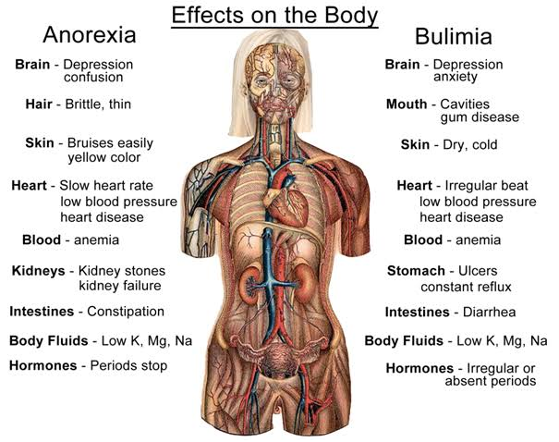
Every organ and system effected by eating disorders
Notes:
An and bn can lead to dysfunction of every organ system

Slide 11
Eating Disorders are Psychiatric disorders with significant, potentially fatal medical complications

Slide 12
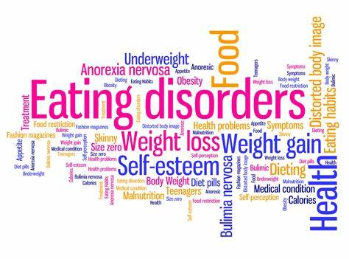
Highest Mortality rates in any psychiatric illness
Death from physical complications and suicide

Slide 13
INDICATIONS FOR ACUTE HOSPITALISATION
PHYSICAL SYMPTOMS: SYNOCOPAL EPISODES, CHEST PAIN , DECREASE EXERCISE TOLERANCE, LOW URINE OUTPUT CONFUSION
ENERGY INTAKE& FLUID: LITTLE OR NO NUTRITIONAL INTAKE FOR 5 DAYS OR MORE, FAILURE TO DRINK ADEQUATE FLUID
WEIGHT:ACUTE WEIGHT LOSS, RAPID WEIGHT LOSS , SERVERE MALNUTRITON (BMI<14), TOTAL BODY WEIGHT <75% EXPECTED FOR HEIGHT ( <18 YEARS)
PHYSICAL EXAMINATION:BRADYCARDIA <50 BPM(<18 YEARS) <40 BPM (ADULTS) POSTURAL INCREASE OF HR >30 BPM ( CHILDREN AND ADULTS) HYPOTENSION SYSTOLIC BP<80MM HG (CHILDREN & ADULTS ) POSTURAL DECREASE BP>20MMHG( CHILDREN &ADULTS) CAPILLARY RETURN >1 SEC, LOW JVP( DEHYRATION) HYPOTHERMIA< 35.5
:

Slide 14
INDICATIONS FOR ACUTE HOSPITALISATION
ECG ABNORMALITIES : ARRYTHMIA, POLONGED QTc, > 450 msec, DIMINISHED AMPLITUDE OF QRS COMPLEX & T WAVES
ABNORMAL BIOCHEMISTRY : BLOOD GLUCOSE IN URINE<2.5 mmol/l, KETONES IN URINE, POTASSIUM <3.0mmol/l ( < 18 YEARS ) < 2.5mmol/l ( ADULTS) SODIUM < 125 mmol/l HYPOPHOSPHATEMIA ANYTHING BELOW NORMAL RANGE ( < 18 YEARS ) 0.3mmol/l (ADULTS)
SUCIDALITY WITH AN ACTIVE PLAN
ACUTE COMPLICATIONS OF MALNUTRITION OR ACUTE IMPACT ON EXHISTING MEDICAL CONDITIONS
Notes:
RENAL FAILURE , GASTRIC DILATION , CARDIAC FAILURE , DELERIUM, DIABETES , SEZUIRES ECT……

Slide 15
Medical complications of eating disorders
https://youtu.be/oHJLQTAa7nI

Slide 16
Red flags
Physical symptoms
Energy intake and fluid
Weight
Physical examination
Egg abnormalities
Abnormal biochemistry
Suicidality with an active plan
Acute complications of malnutrition /acute impact on existing medical conditions
Notes:
Use gp hand out : when to hospitalise

Slide 17
Nine truths of eating disorders
Truth #1: Many people with eating disorders look healthy, yet may be extremely ill.
Truth #2: Families are not to blame, and can be the patients’ and providers’ best allies in treatment.
Truth #3: An eating disorder diagnosis is a health crisis that disrupts personal and family functioning.
Truth #4: Eating disorders are not choices, but serious biologically influenced illnesses.
Truth #5: Eating disorders affect people of all genders, ages, races, ethnicities, body shapes and
weights, sexual orientations, and socioeconomic statuses.
Truth #6: Eating disorders carry an increased risk for both suicide and medical complications.
Truth #7: Genes and environment play important roles in the development of eating disorders.
Truth #8: Genes alone do not predict who will develop eating disorders.
Truth #9: Full recovery from an eating disorder is possible. Early detection and intervention are important.

Slide 18
Questions ?

Slide 19
References
Arcelus, J., Mitchell, A. J., Wales, J., & Nielsen, S. (2011). Mortality rates in patients with anorexia nervosa and other eating disorders. Archives of General Psychiatry, 68(7), 724. https://doi.org/10.1001/archgenpsychiatry.2011.74
Castillo, M., & Weiselberg, E. (2017). Bulimia nervosa/Purging disorder. Current Problems in Pediatric and Adolescent Health Care, 47(4), 85-94. https://doi.org/10.1016/j.cppeds.2017.02.004
Eating disorders: Recognition and treatment. (2017, May 23). https://www.nice.org.uk/guidance/ng69/chapter/Recommendations#treating-bulimia-nervosa
Fairburn, C. G., Bailey-Straebler, S., Basden, S., Doll, H. A., Jones, R., Murphy, R., O'Connor, M. E., & Cooper, Z. (2015). A transdiagnostic comparison of enhanced cognitive behaviour therapy (CBT-E) and interpersonal psychotherapy in the treatment of eating disorders. Behaviour Research and Therapy, 70, 64-71. https://doi.org/10.1016/j.brat.2015.04.010
Gibson, D., Workman, C., & Mehler, P. S. (2019). Medical complications of anorexia nervosa and bulimia nervosa. Psychiatric Clinics of North America, 42(2), 263-274. https://doi.org/10.1016/j.psc.2019.01.009
Hansen, S. J., Stephan, A., & Menkes, D. B. (2021). The impact of COVID-19 on eating disorder referrals and admissions in Waikato, New Zealand. Journal of Eating Disorders, 9(1). https://doi.org/10.1186/s40337-021-00462-0
Hay, P., Chinn, D., Forbes, D., Madden, S., Newton, R., Sugenor, L., Touyz, S., & Ward, W. (2014). Royal Australian and New Zealand college of psychiatrists clinical practice guidelines for the treatment of eating disorders. Australian & New Zealand Journal of Psychiatry, 48(11), 977-1008. https://doi.org/10.1177/0004867414555814
Hudson, J. I., Hiripi, E., Pope, H. G., & Kessler, R. C. (2007). The prevalence and correlates of eating disorders in the national comorbidity survey replication. Biological Psychiatry, 61(3), 348-358. https://doi.org/10.1016/j.biopsych.2006.03.040
Nitsch, A., Dlugosz, H., Gibson, D., & Mehler, P. S. (2021). Medical complications of bulimia nervosa. Cleveland Clinic Journal of Medicine, 88(6), 333-343. https://doi.org/10.3949/ccjm.88a.20168
Santomauro, D. F., Melen, S., Mitchison, D., Vos, T., Whiteford, H., & Ferrari, A. J. (2021). The hidden burden of eating disorders: An extension of estimates from the global burden of disease study 2019. The Lancet Psychiatry, 8(4), 320-328. https://doi.org/10.1016/s2215-0366(21)00040-7
Shapiro, J. R., Berkman, N. D., Brownley, K. A., Sedway, J. A., Lohr, K. N., & Bulik, C. M. (2007). Bulimia nervosa treatment: A systematic review of randomized controlled trials. International Journal of Eating Disorders, 40(4), 321-336. https://doi.org/10.1002/eat.20372
Wade, T. D. (2019). Recent research on bulimia nervosa. Psychiatric Clinics of North America, 42(1), 21-32. https://doi.org/10.1016/j.psc.2018.10.002
Waller, G., Tatham, M., Turner, H., Mountford, V. A., Bennetts, A., Bramwell, K., Dodd, J., & Ingram, L. (2018). A 10-session cognitive-behavioral therapy (CBT-T) for eating disorders: Outcomes from a case series of nonunderweight adult patients. International Journal of Eating Disorders, 51(3), 262-269. https://doi.org/10.1002/eat.22837

Slide 20
REFERENCES
https://www.ncbi.nlm.nih.gov/pmc/articles/PMC6338222/
https://wharaurau.org.nz/
https://www.beateatingdisorders.org.uk/
https://starship.org.nz/guidelines/eating-disorders-management-of/
https://www.ed.org.nz/eating-disorders-explained/causes/
https://www.aedweb.org/resources/about-eating-disorders

Slide 21
Marzipan guidelines
https://www.rcpsych.ac.uk/docs/default-source/members/faculties/eating-disorders/marsipan/junior-marsipan-cr168.pdf?sfvrsn=65e82800_2

Slide 22
What psycho-education is useful to give out ?
https://www.cci.health.wa.gov.au/Resources/For-Clinicians/Eating-Disorders
Notes:
Not all at once
Effects of starvation
Gastro , physical effects

