Slide 1
Primary Care Resilience Tool
Key points of contact:
Kate Dowson
General Manager, Primary Care
Te Whatu Ora Waitematā, Te Toka Tumai Auckland and Counties Manukau districts
kate.dowson@middlemore.co.nz
Callum Chapman
Manager - Strategy and Engagement, Regional Emergency Management Service
Te Whatu Ora Northern Region
callum.chapman@nra.health.nz

Slide 2



What’s the gap?
    Hospital and specialist services can communicate their demand and capacity using real-time quantitative data. Primary and community care services don’t have the same.
    Primary and community care has many disparate providers that are privately owned.
    Challenges for local providers to share information.
    Limited on the ground intelligence collected systematically = hard to understand system pressures either for BAU or in an emergency response.

Slide 3






What is the Primary Care Resilience Tool?
For each Practice/Clinic/Pharmacy/Service:
Open or closed
(incl. partially closed or virtual only)
Overall status
(red, amber, green)
Workforce pressures (clinical and non-clinical staffing levels)
Approximate wait times (GP and UCC only)
(third next available appointment for routine and urgent + virtual and walk in)
Resource pressures (critical supplies, IT, infrastructure)
Free text
(direct comments and feedback)

Slide 4
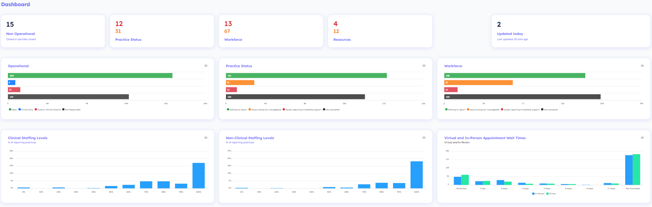
Primary Care Resilience Tool Dashboard
Region: Northern
Period: Sample report
General Practice and Urgent Care

Slide 5
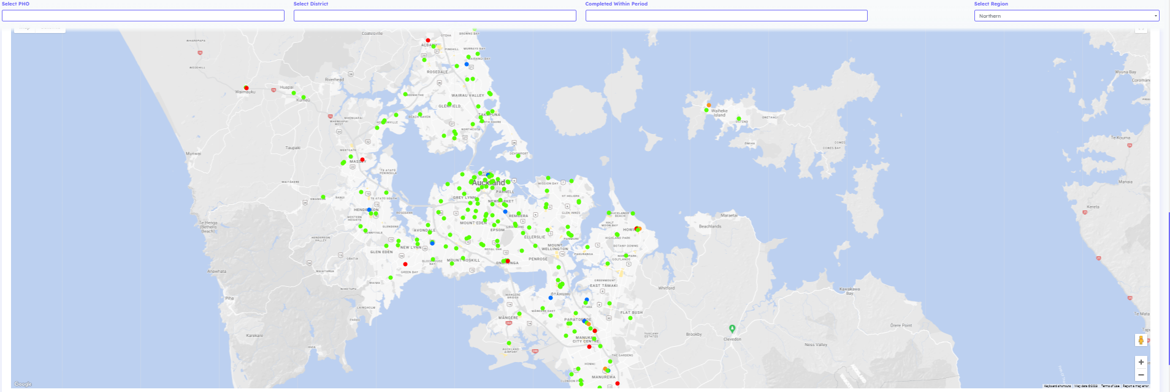
Primary Care Resilience Tool Dashboard
Region: Northern
Period: Sample report
General Practice and Urgent Care

Slide 6








Timeline
Developed a new tool in conjunction with PHOs in preparation for Delta outbreak
Developed long term strategy
Enhancements made to the tool – questions added around clinic wait times and staffing levels
Engagement with Home and Community Support Services
Review of a previous tool used during 2020 COVID-19 outbreak
Added pharmacies
Northland scoped for inclusion
Delta Outbreak
(August)
Omicron Outbreak
(January)
Launched first version
(August)
Launched PCRT 2.0
(November)
2023
2021
2022

Slide 7




So what?
On the ground primary and community care intelligence gathering
Stating a case for change
Aggregated information about primary care pressures.
Data can be compared with secondary care reporting.
Building an understanding of primary care - “telling the story”.
Informed decision making at all levels
Strengthening collective ways of working between services, PHOs and Te Whatu Ora and Te Aka Whai Ora.
We can ensure care is delivered where it’s most needed – equity approach.
Data informed timely decision-making.
Sharing pressures regionally and nationally to inform policy.
Collective ways of working
Local providers able to share pressures with nearby health services.
Local ways of working to manage pressures together.
Notes:
The so what is – how do providers and those in the sector use this information?
It gives us unfiltered on the ground information from frontline providers, which we can then aggregate across the primary and community sector.
This supports a few things:
Sideways - local ways of working between providers in an area – particularly in an emergency – e.g. power cut
Down - PHOs and Te Whatu Ora at a regional level can work with providers – we can hear and respond – e.g. confusion about policy and guidance – use of medinz to clarify
Up - Te Whatu Ora at a regional level can use it to support informed decision making based on what’s happening on the ground , consider regional solutions and advocate nationally for primary and community
Also allows us to show alongside secondary care information, tell the primary care story, and state the case for change.
– e.g. winter planning solutions came up with regional solutions and national level advocacy for the region, could show the significant pressure primary care was also under and tested some local solutions based on this feedback (eg analgesia in Counties, we heard from the tool that there were a lot of consults) – equity approach.

Slide 8









Next Steps
Next 3 – 6 Months
Future Scope
    Aged Residential Care – Development of an ARC dashboard which includes vacancy status reporting.
    Data Integration – Scope other data sets that can be incorporated into the tool (such as secondary care data sets)
    Home and Community Support Services – Development of a pilot in the Northern Region for Home and Community Support Providers.
    Provider input enhancements - This involves enhancing Māori and Pacific provider inputs and dashboard views.
    National Rollout – Making the current version of the PCRT available to all General Practices, Urgent Care Clinics and Pharmacies across Aotearoa.
    Expansion of services – This involves extending the tool to additional community services such as telehealth providers and ambulance providers.
    Formalise Data and Digital support for the Primary Care Resilience Tool.
    Ongoing enhancements - This involves the ongoing enhancement of the question sets and technical functionality of the tool.
    Integrated Dashboard – Develop an integrated dashboard across services.
    Emergency Management Integration - This involves adding Emergency Management information layers to the tool.

Slide 9
Appendix One: Test site login details
resiliencetool.i3-uat.nz
username: TeWhatuOra
password: an0therPWD!

