Slide 1
Assisted Dying Services - a readiness guide

Slide 2
Are you ready ?
Have key clinical and admin staff do the three learnonline modules.
Use this group to adapt the Pinnacle draft policy to your practice setting.
Appoint a “champion” who can keep up to date and provide the rest of the team with advice when needed.
Ask all staff to do at least the first learnonline module, ideally clinical staff do all three.
Hold a staff meeting to discuss your practice policy on assisted dying and explore staff concerns.
Use the scenarios to test out your practice readiness.

Slide 3
Assisted Dying A (draft) practice meeting resource

Slide 4
Overview
People will be able to request assisted dying from 7 November 2021.
A person must meet strict criteria to be eligible for assisted dying.
A person must be competent to make an informed decision about assisted dying.
The person must raise the topic of assisted dying first, it must not be presented to them as an option.
Providers of assisted dying services must have the appropriate skills and knowledge to assess, counsel and administer medication.
The process can stop at any time.
Notes:
All practices have a conversation with staff

Slide 5
Have you done the learnonline modules yet?

Slide 6
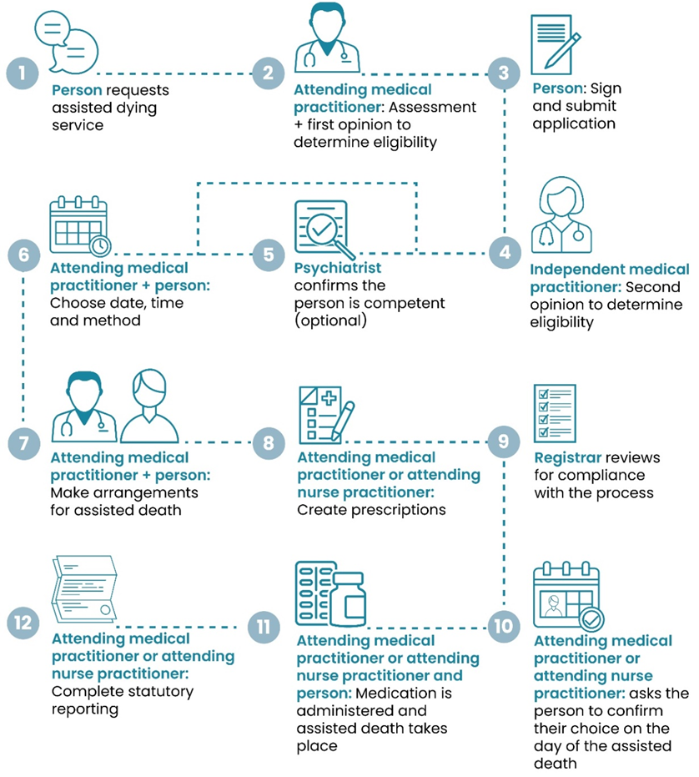
This is not an acute service.
It will usually take several weeks at least from the person making the request until the service is approved.
To be eligible a person must meet ALL the following criteria:
aged 18 years or over
a citizen or permanent resident of New Zealand
suffering from a terminal illness that is likely to end their life within 6 months
in an advanced state of irreversible decline in physical capability
experiencing unbearable suffering that cannot be relieved in a manner that the person considers tolerable
competent to make an informed decision about assisted dying.

Slide 7
Options and obligations
Medical and nurse practitioners, psychiatrists and pharmacists can choose whether they would like to be involved with or provide assisted dying as a service.
Providers without the necessary skills and training need to refer on to another provider on the Support & Consultation for End of Life in NZ (SCENZ) group list.
Conscientious objectors may choose not to provide assisted dying services.
Conscientious objectors have a legal obligation to inform the person of their objection and direct them to the SCENZ group list.
Health professionals cannot inhibit someone's access to assisted dying services

Slide 8
Oversight of assisted dying
The MOH is responsible for the Act and the work program to implement it.
The SCENZ group
maintains a list of health practitioners who are willing to be involved in assisted dying.
is responsible for standards of care, medical and legal procedures and provision of practical assistance.
The Registrar (assisted dying)
checks that the processes required by the Act are complied with and approves care to the patient to continue.
The EOLC review committee
considers reports about the assisted death, reports to the registrar on compliance with the Act.

Slide 9
Communication issues
It is important to think about how you will respond if assisted dying is raised with you.
The person requesting assisted dying must be the first to raise it.
A health professional cannot suggest assisted dying as an option or initiate discussion unless the person has done so first.
If someone asks about options (i.e. palliative care) you cannot suggest assisted dying.
If a friend/relative asks about assisted dying you can direct them to general information about the service.
Whanau, carers, welfare guardians or EPOA cannot request or make a decision about assisted dying on a persons behalf.

Slide 10
In our practice …
XXXXX is our practice champion – if anyone has any questions about assisted dying let them know and discuss the situation.
All conversations about assisted dying are recorded in the PMS – remember that this has to be raised by the patient first – document when this happens.
This very sensitive topic, we need to look after ourselves. Our practice support mechanisms are …..
Remember Pinnacle provides free confidential EAP access for all staff (https://www.eapservices.co.nz/)
This is NOT a topic for ANY external conversation, EVER. Do NOT talk about assisted dying requests or services where your conversation might be overheard or with anyone outside our team.

Slide 11
Scenarios – are we ready ?
Consider …
Does the person understand their other options for care, such as palliative care?
Is the person making an informed decision of their own free will?
How are the person’s cultural needs being respected and upheld?
How are the person’s spiritual needs being respected and upheld?
How are the person’s psychological needs being respected and upheld?
Is the service being provided in a person- and whānau-centred way?
Would the person benefit from any additional health care or social supports?
How are the staff working with this person being kept safe?
How are the person’s rights under the Code of Health and Disability Services Consumers’ Rights being upheld?
What would we do ?

Slide 12
Scenario one – Rangi
Context | Rangi is an 85-year-old woman who lives alone in your town. Her whānau is spread across New Zealand. Rangi has end stage heart failure. Rangi would like to return to her turangawaewae in Kaitaia to die on the marae.
Situation | Rangi has requested assisted dying through her general practitioner and has been found eligible. Her general practitioner is not able to travel to Kaitaia to perform the assisted death and would like to support Rangi to get support in Kaitaia.
Considerations | How might the general practitioner arrange for a medical or nurse practitioner in Kaitaia to administer the medication? Who helps support and arrange Rangi’s travel to Kaitaia from your town, including any medical care that she may need during the journey? How does Rangi and her whānau find out if her assisted death is able to take place at the marae and then discuss the outcome of this with the practitioner? If the assisted death can take place on the marae, how will Rangi and her whānau let the medical or nurse practitioner know the tikanga to be followed on this marae? If the assisted death cannot take place on the marae, what other options may be available to Rangi? Throughout the assessment process and at the time of the assisted death, how will her general practitioner and any other staff involved in her care ensure her cultural needs are upheld, including any spiritual support or guidance?

Slide 13
Scenario two – Josie
Context | Josie is a 75-year-old woman who lives in an aged care facility in your town. Her daughter, Susie, visits regularly. Josie has pancreatic cancer. Josie has requested assisted dying by contacting the Support and Consultation for End of Life in New Zealand (SCENZ) Group directly to find a suitable medical practitioner. She is waiting for her first assessment for eligibility. The aged care facility conscientiously objects to assisted dying services and does not allow assisted deaths to take place in its facilities.
Situation | Josie would like to leave the facility and have her assisted death take place in Susie’s home. A nurse at the aged care facility notices some conflict between Josie and Susie. Susie wants Josie to stay in the facility and thinks Josie requesting assisted dying is out of character. The nurse is concerned about Josie as the conflict with Susie has really upset her.
Considerations | Are residents and prospective residents aware of the facility’s conscientious objection? Does the facility have a policy in place for if a resident requests assisted dying that means medical practitioners can meet their statutory duties to provide assisted dying services unless due to conscientious objection or lack of competence? Is there clear guidance on who the nurse should raise her concerns with? How might the medical practitioner assessing Josie’s eligibility for assisted dying be notified of the incident between Josie and Susie? Who might be involved in ensuring that no coercion has taken place? If Josie is found to be eligible and goes ahead with accessing assisted dying services, what are her options if Susie refuses to have her move to her home?

Slide 14
Scenario three – Tipene
Context | Tipene is a 62-year-old man living in a rural community in your area. Tipene has complex, chronic health needs, including heart failure. He has been living with depression for many years. His regular general practitioner is an hour’s drive away. Tipene cannot drive and relies on whānau and support services to help him get to medical appointments.
Situation | During a telehealth appointment with his regular general practitioner, Tipene requests to start the assessment process for assisted dying. The general practitioner does not provide assisted dying services as he does not consider himself competent to do so. He does not have a conscientious objection to assisted dying.
Considerations | What steps should Tipene’s general practitioner take to ensure Tipene can access an assessment for assisted dying? How else may the general practitioner be involved in supporting Tipene through the assisted dying process? What should the general practitioner do to ensure that Tipene understands what care options he has? If Tipene goes ahead with getting an assessment for his eligibility for assisted dying, what additional considerations should the attending medical practitioner make given Tipene’s ongoing health needs, including his depression? What complexities might Tipene’s rural location add to this situation?

Slide 15
Useful links
MOH resources and more scenarios are all available on the learnonline site
https://learnonline.health.nz
This requires a login, and provides access to webinars, the training modules for all staff, and other resources.
Access to the in-depth training for providers of the service needs to be requested by email from the team at eolc@health.govt.nz
Most of the resources are also on the MOH website:
https://www.health.govt.nz/our-work/regulation-health-and-disability-system/end-life-choice-act-implementation/end-life-choice-act-implementation-resources
The Conversation Guides and Handbook are very useful
The section 88 contract can be found here https://www.gazette.govt.nz/notice/id/2021-go4217/#Subpart%20BC
The Pinnacle website is excellent of course https://www.pinnaclepractices.co.nz/resources/end-of-life-choice-act/

