Slide 1
HealthPathway – Hepatitis C
Jo de Lisle – Te Manawa Taki hepatitis C Programme Lead

Slide 2
To eliminate hepatitis C by 2030 NZ has signed up
WHO elimination goal

Slide 3
Estimated numbers New modelling - 25 to 35,000 in New Zealand Only half know they have it Te Manawa Taki (Midland) Region is 9374 Nationally treated under 10,000

Slide 5
Chronic Hepatitis C -Who reviewed the pathway?
The draft nationally agreed pathway was sent out to the four regions for review.
The first time this has happened!
Reviewed by:
Primarycare
Secondary
Consumers
Māori Health Providers
HARM reduction Providers
Pacifica
Corrections
Hepatitis C nurses

Slide 6
Any lessons learnt?
Initially pathways were written for general practice to access, but now clinical community providers can access
Not all providers understood the difference of a clinical pathway versus how the pathway would be delivered
Collating all the feedback from around the country is a logistic skill needed
Many people wanted to contribute but were just too busy

Slide 7
Partners in Primary & Community Pānui | 17 August 2023
The introduction of national health pathways such as the pathway for Hepatitis C, demonstrates how we can organise people’s care across clinicians and settings, taking account of how local services are arranged and drawing on the best available evidence for clinical practice.
Transition to a unified, smarter, sustainable, and equity-led health system

Slide 8
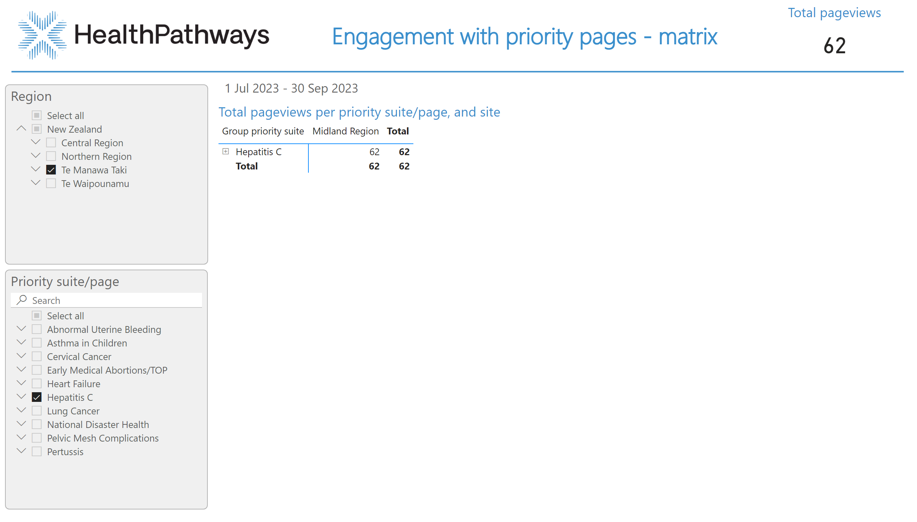
Priority pages matrix
Notes:
Total pageviews per priority suite/page, and site
No alt text provided
image
No alt text provided
basicShape
No alt text provided
Region
No alt text provided
Priority suite/page
No alt text provided
Timeline1447991079100
No alt text provided
Total pageviews
No alt text provided
textbox
No alt text provided
card
No alt text provided

Slide 9
Absolute page views of the Hep C pathway for all sites
since 1 July 2023:

Slide 10
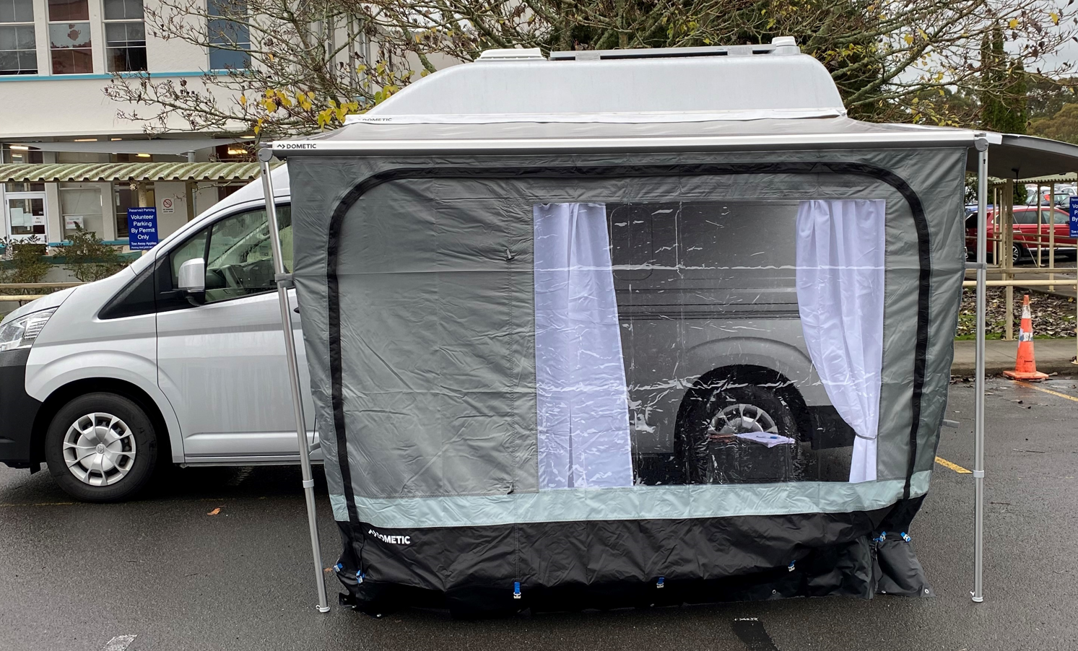
Regional nurse lead service (Clinical oversite by Dr Frank Weilert and his team at Waikato) Mobile Berm Hauora days Home visits Partnerships GP rooms Pharmacy etc We remove barriers to treatment, cost, access and we link to care. Many are People who inject drugs (PWID) Treat everyone Support, encourage and educate people around hep C and treatment
Te Manawa Taki Community hepatitis C service

Slide 11
Te Manawa Taki Community hepatitis C service
Indici
Secure IT network
Message GP’s if consented
ED consults
BPAC eReferral to the community service

Slide 12
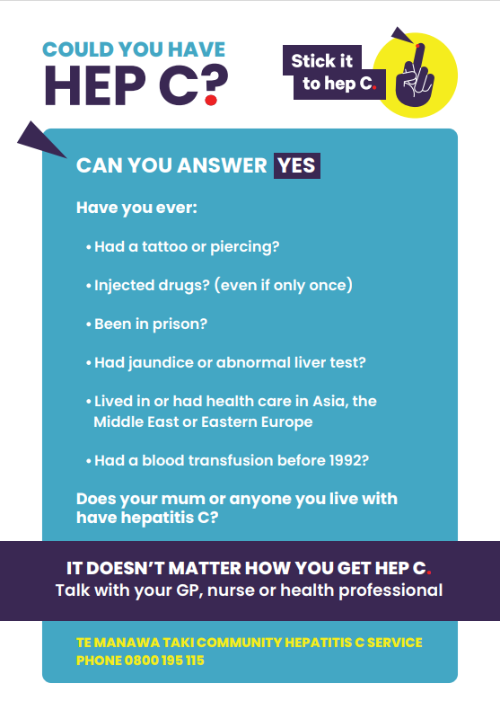
How to start the conversation

Slide 13
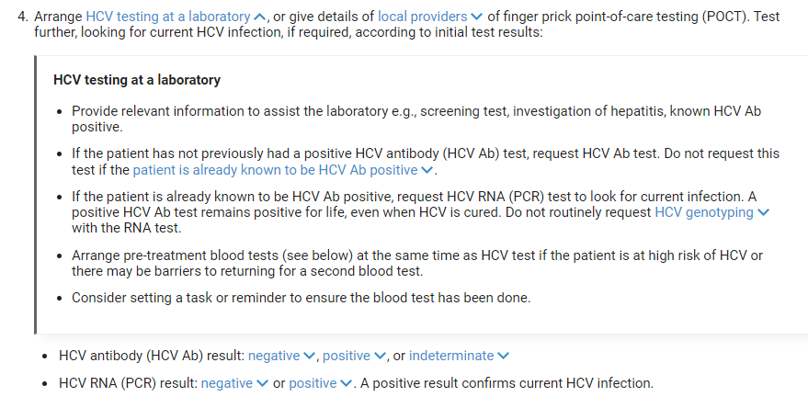
How we deliver the HealthPathway

Slide 14
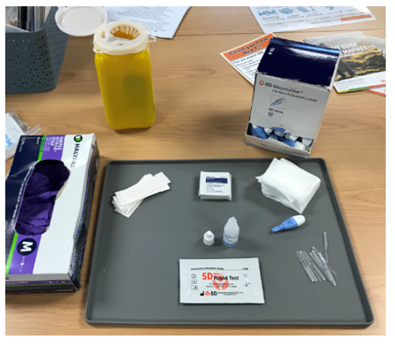
Point of Care Testing and/or Blood draw

Slide 15
Liver fibrosis assessment

Slide 16
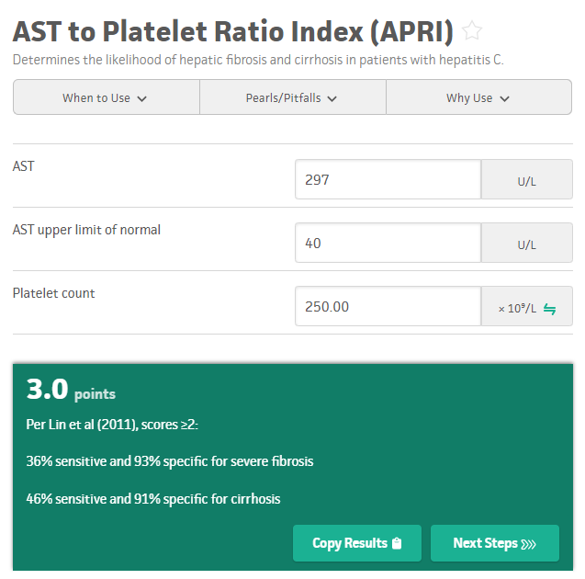
APRI Score or Fibroscan

Slide 17
Treatment
Maviret
Two antivirals in one pill
3 pills per day for 8 weeks
Maviret prescribed through the GP or through our service
*Note: there is a reclassification in progress for pharmacists/nurses to be able to supply Maviret

Slide 18
Finally…
We need your help to find people with hepatitis C Hasn’t been well coded historically Read Code for Chronic Hep C = A70z0.00 SNOWMED code: 50711007 ICD 10 code: B182 Too busy? Refer to via BPAC to: Hepatitis C Community service – Fibroscan, Community based Refer to community testing https://www.stickittohepc.co.nz

Slide 19
#StickitothepC
Awareness campaign launch July 2022
ARCHIVED-Stick it to hep C - YouTube

