Slide 1
How we do things 'round here....
Te Manawa Taki Community Healthpathways update
Sexual health
Dr Jo Scott-Jones : drjo@pinnacle.health.nz
Notes:
Do we open with karakia?
Then go to INTRODUCTIONS (Whaanauatanga)
Whaanautanga – everyone to give brief introduction of self.
Name → role → favourite song to sing in the shower or favourite movie of all time (this is for a bit of fun and getting to know each other)
Then ask: show of hands who have experience of having goal setting conversations with their teams / who needs a refresher / anyone think they are a pro at setting and achieving goals (these are the guys we could call on for some examples from past experience)

Slide 2
Ngā mihi nui
Drs – Lisa Hughes ( Lakes ) Sarah Callaghan (Taranaki) Chris Tofield ( BOP ) Landi Cranstoun (Taranaki) Angela Fairweather, Geraldine Tennant, Mark Taylor, Fiona Campbell ( Waikato )
Who are your clinical editors and healthpathways clinical advisors as well as your TWO GP liaisons
Jo Hollobon, Angela Francis, Christine Scott – who make things happen
Nina Scott, Ngāpei Ngatai, Liza Lack, Jane Abel who provide oversight and guidance to the programme across the region
Notes:
Do we open with karakia?
Then go to INTRODUCTIONS (Whaanauatanga)
Whaanautanga – everyone to give brief introduction of self.
Name → role → favourite song to sing in the shower or favourite movie of all time (this is for a bit of fun and getting to know each other)
Then ask: show of hands who have experience of having goal setting conversations with their teams / who needs a refresher / anyone think they are a pro at setting and achieving goals (these are the guys we could call on for some examples from past experience)

Slide 3
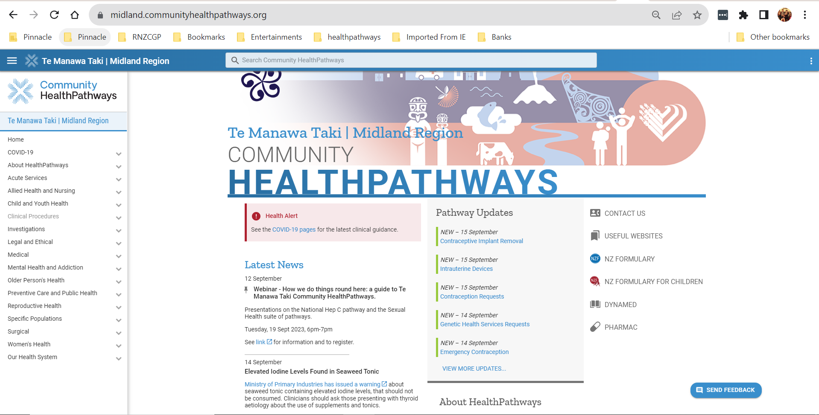
Key messages – sexual health pathways

Slide 6
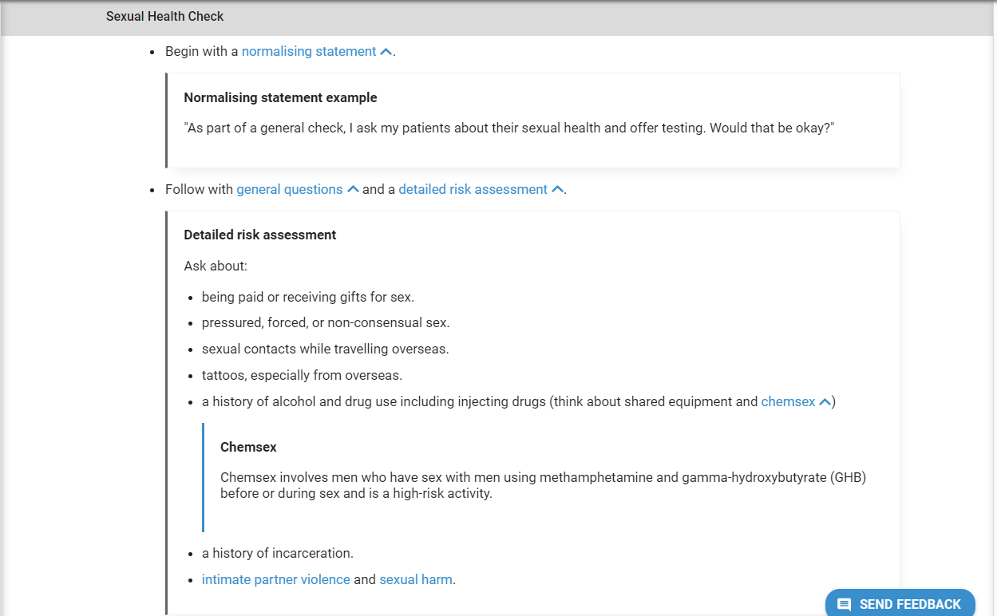

Slide 7
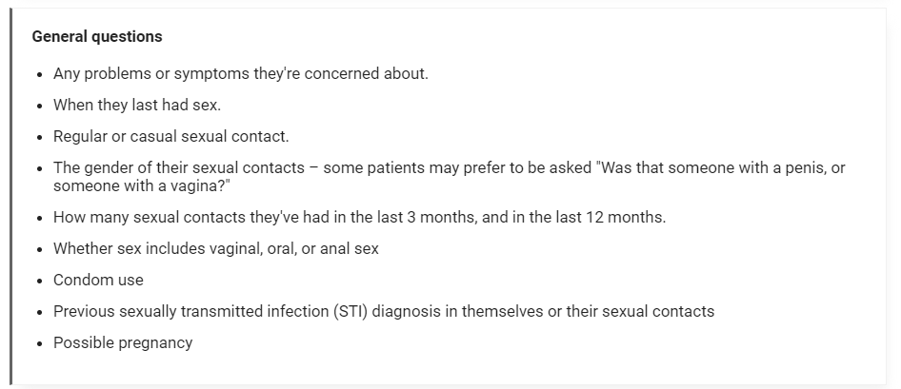

Slide 8
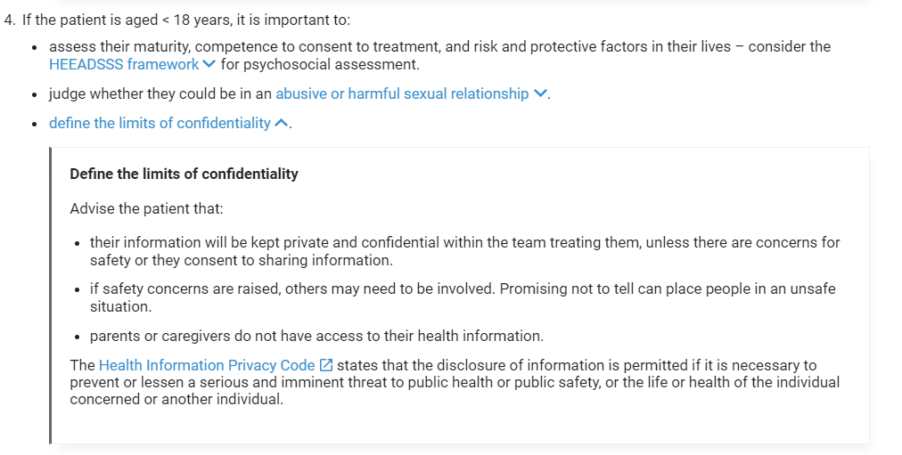

Slide 9
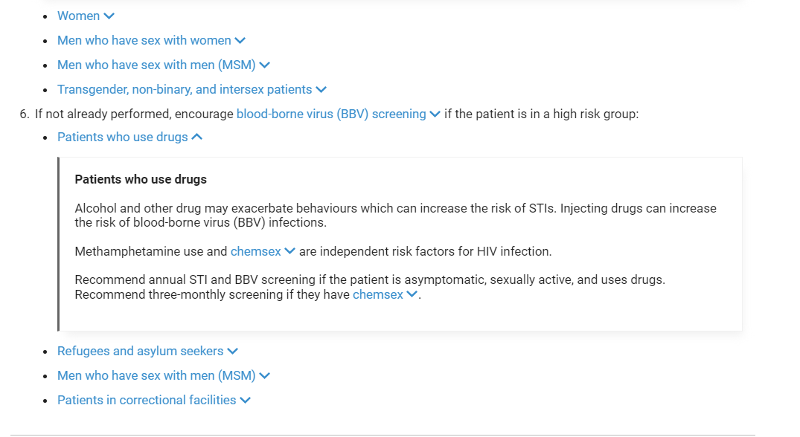

Slide 10
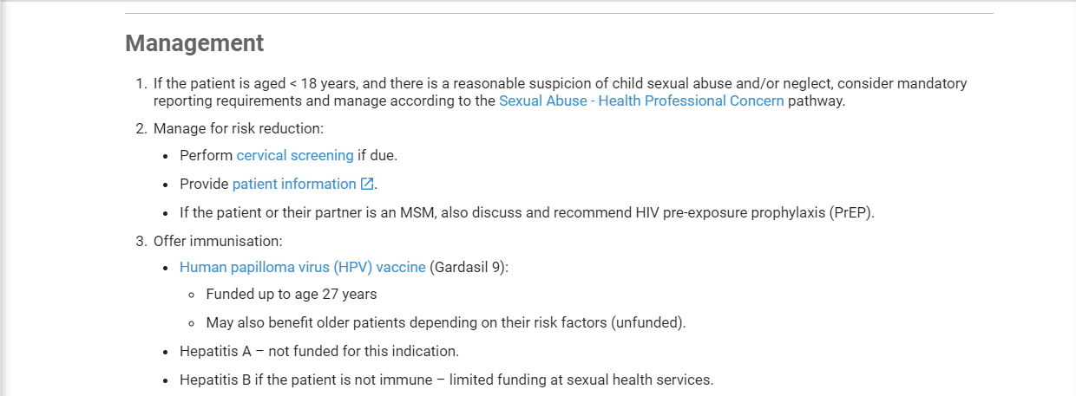

Slide 11
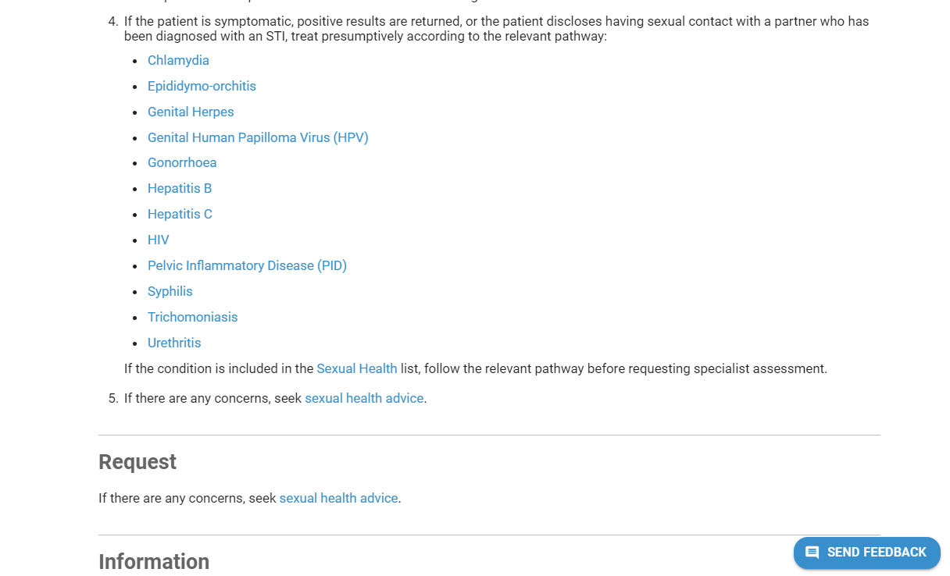

Slide 12
Chlamydia :
Test opportunistically with cervical cancer screening, antenatal care, contraception advice, and travel medicine.
Symptoms -
Anorectal symptoms (often absent) – Anal pain, tenesmus, discharge, rectal bleeding, irritation, change in bowel function, painful defecation
Vaginal PCR/NAAT swab
Wipe the swab around the vaginal entrance, then insert the swab 4 cm (a thumb’s length) into the vagina. Count slowly to 5 and replace in the swab container.
Snap off the cotton bud at the black line and screw the lid on the container tightly. See local swab guides.
Advise the patient to abstain from sex (including oral sex) or use condoms:
until 7 days after treatment.
until 7 days after their sexual contacts have been treated.
Manage sexual contacts
Note that patient-delivered partner therapy is not legal in Aotearoa New Zealand.
If the patient is pregnant or has had anorectal chlamydia, arrange a test of cure.
Test of cure
A test of cure is best performed at least 4 weeks after treatment is completed.
A self-collected PCR/NAAT swab (see local swab guides) is recommended.

Slide 13
Genital Herpes
Take herpes simplex virus (HSV) PCR swab using universal transport media (UTM) – swab lesions from base of ulcer or de-roofed blister. If ulcer is dry, consider squeezing the lesion or adding a drop of saline before swabbing.
If recurrent genital herpes is suspected but HSV swab results are negative, consider self-collection of swab at first onset of recurrent symptoms.
Genital Warts
Ninety per cent of genital warts are due to types 6 and 11.
The more common high‑risk types 16 and 18 do not usually cause genital warts, and are found in pre-malignant conditions e.g., cervical intraepithelial neoplasia (CIN), vulval intraepithelial neoplasia (VIN), and anal intraepithelial neoplasia (AIN).
No treatment is an option for asymptomatic warts. Thirty per cent of patients will experience spontaneous clearance of warts over a 6‑month period.
Explain how new warts develop at sites of seeding, which requires introduction of the virus to the basal cells of the skin, often by small cuts or abrasions. In the genital area this may occur through shaving or waxing of pubic hair and should be avoided in affected individuals.
Breastfeeding patients
Cryotherapy or surgical options are recommended.
Topical medication is not recommended.
Be aware HPV is not a notifiable condition and contact tracing is not required as infection may occur 12 months or more prior to visible warts appearing. The patient may disclose to current partners who can be examined and treated.

Slide 14
HIV
Transmission by injecting drug use, paid sex, or perinatal exposure, is very rare in New Zealand.
The incidence of HIV infection peaked in 2016, and has declined since then, probably due largely to the decision by Pharmac to fund pre-exposure prophylaxis (PreP) for MSM at high risk of acquiring infection.
PID
Manage suspected mild to moderate PID immediately, according to type:
Sexually acquired PID
Non-sexually acquired PID
If uncertain, manage as sexually acquired PID:
If a patient is at risk of STIs (i.e., the patient was not investigated for STIs before the gynaecological procedure), then manage as sexually acquired PID.
Have a low threshold for treating and do not wait for test results before starting treatment.
Syphilis
Patients may present with constitutional symptoms such as fever, malaise, headache, and lymphadenopathy.
The skin is involved in over 90% of cases but may have gone unnoticed by the patient.
The rash is usually generalised involving the trunk but may just affect the palms and soles.
The rash can be easily confused with drug eruptions, pityriasis rosea, or guttate psoriasis.
There may be alopecia and condylomata lata (warty growths in the anogenital area).
There may also neurological signs of cranial nerve palsies, ophthalmic signs, and meningitis.
Incubation period 2 to 24 weeks (average 6 weeks).
If untreated, symptoms slowly resolve over a period of weeks, but may recur.

Slide 15
Trichomonas Treatment failure
Most treatment failure is due to sex with an untreated partner or non-adherence to treatment but resistance or reduced susceptibility can occur in approximately 4 to 10% of cases. ¹
Check treatment adherence and the risk of reinfection, and try a repeat course. Give metronidazole 400 mg orally with food, twice a daily for 7 days. 40% of patients respond to a repeat course of standard treatment. ¹
If the patient fails to respond to two full 7-day courses, seek sexual health advice or request sexual health assessment. They can facilitate repeat Trichomonas PCR testing with additional culture and antiprotozoal sensitivities via a reference laboratory.
Non-gonoccoccal urethritis
Manage sexual contacts
For non-gonococcal urethritis contacts, prescribe empirical treatment with doxycycline 100 mg orally twice a day for 7 days, assuming no allergies or contraindications.
If gonorrhoea is suspected in the index case, use ceftriaxone 500 mg as a single dose, plus azithromycin 1 g orally.
Investigations
Consider taking a herpes simplex virus (HSV) PCR swab of the urethral meatus using universal transport media (UTM) if:.
If persistent or recurrent urethritis, collect a first-catch urine for:
Repeat chlamydia and gonorrhoea PCR testing
Trichomonas
Mycoplasma genitalium
Mycoplasma genitalium
Consider testing if persistent symptoms of urethritis, other tests are negative, and not responding to treatment.
Seek sexual health advice or clinical microbiologist advice first.
Clinical details on laboratory request forms are essential.

Slide 16
Have a look around ! (& claim some MOPS Points) What were the key learnings from this activity? If you apply your learning, what are the benefits or implications for others? Think of a situation where you could apply this learning. What would you do differently now? He ngā patai ?
drjo@pinnacle.health.nz

