Slide 1
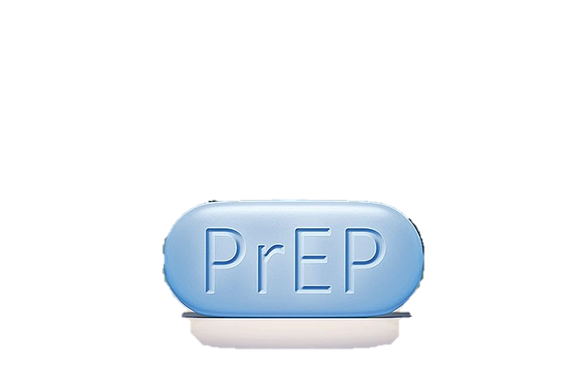
Prescribing PrEP in Primary Care
How are we going to do this? All you need to know to get started

Slide 2
WHO does this apply to?
PrEP is an HIV prophylaxis medication using two retro-antivirals (Tenofovir and Emtricitabine prevent a key step in the HIV replication cycle)
can be considered for anyone at risk of acquiring HIV
Although..not funded for everyone (more later)
Must be deemed HIGH RISK for PHARMAC funding
If approved but prescription fees a barrier -
Can be FULLY funded if international student or have CSC through Green Cross Pharmacy (NZAF have partnered with Green Cross) - though there is only 1 coupon for every 10 prescriptions
Other non-scripted options to pay top dollar via PHARMAC ($1000/mnth), import from overseas

Slide 3
Why PrEP? Why us?
PrEP became subsidized in March 2018
Prior to this we had to wait for affected patient to have decline in T lymphocyte CD4 cells (primary HIV receptor cells)
Without treatment -> AIDS developed
Increased vulnerability
Greater morbidity, higher mortality
Also reduces the viral load with prompt treatment of PEP antiretrovirals (within 72 hours of potential exposure) = no longer transmitting to others

Slide 4
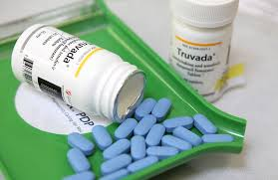
NEW ZEALAND
Wants to ERADICATE new HIV infections by 2025 (BPAC)
Only one of 5 countries in the world to fully fund PrEP

Slide 5
PREP Positive Impact – NZ data
Early diagnosis and treatment of HIV (and those at high risk utilizing PrEP) is the key to reducing transmission rates in NZ
In 2020 --> 162 TOTAL new cases of HIV – 49 MSM were thought to have contracted HIV in NZ
50.5% decrease from peak in 2016 but increased from past two years due to COVID travel bans
32% increase in the number of people accessing medication
19 diagnosed with AIDS in NZ 2019, late Dx a concern
2839 people in New Zealand are receiving treatment for HIV
(3500 people when I did this talk in 2019)
Notes:
Receptive anal intercourse has a higher risk of HIV infection than vaginal intercourse because the rectal mucosa separating deposited semen from cells susceptible to infection is thinner and the surface area of mucosa exposed to the virus is much larger
1998-2020, there were 193 births to women known to be living with HIV in New Zealand. None of these children have been infected with HIV
Heterosexual numbers - In 2020, there were 36 people found to be heterosexually infected with HIV, 106 were gay, bisexual and other men who have sex with men (GBM

Slide 6
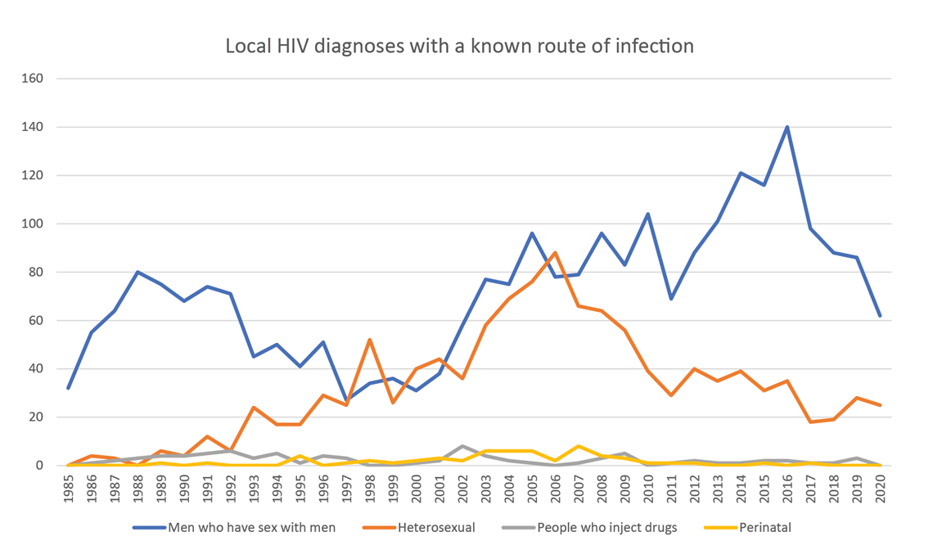

Slide 7
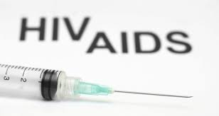
Demonstrated Efficacy -
MSM population
Heterosexual Adults
Injecting Drug Users
It should be noted that: trans people have not been well studied as of yet
Just to clarify – transgender woman means assigned male at birth and now identifies as a female

Slide 8
Risk reduction
MSM at highest risk
Virus ++ concentrated in seminal fluid
After 7 days treatment, risk of infection rectally is almost eliminated
Recommend condoms first 7 days (always!)
99% RR with perfect adherence
96% RR with 4 days taken per week
76% RR with 2 doses per week
Treatment lasts for 7 days after last dose taken

Slide 9
HOW to prescribe?
Read around guidelines. BPAC and NZAF excellent
https://bpac.org.nz/2019/prep.aspx
https://www.nzaf.org.nz/awareness-and-prevention/hiv/aids/
ASHM online courses - https://vimeo.com/showcase/5538177
Email NZAF to advise you’re on board so they can add you to "the map" and Waikato to let the clinic know you will assist.
Next, meet with patient and determine their risk
If high risk -> you now only need SA form for script
If low/med risk and still want med -> unfunded options
About 66 dollars a month - Or, purchase off label (expensive – 1,000/month)
Notes:
Australasian Society for HIV Medicine
This is a huge change as a few years ago I needed to fax SA criteria to Waikato and wait 24-48 hours to have it approved

Slide 10
Who is funded for PrEP?
Funded Criteria for HIGH RISK:
Male (cis or trans) or transgender female (male at birth, IDs as female
Has sex with males
Likely to have multiple episodes of anal intercourse without condoms in the next three months
AND Have had any of the following in past 3 months:
Regular sex partner of a known HIV + person (not on Tx/detectable viral load) and not using condoms regularly
>/1 episode of receptive anal intercourse with a >/1 casual male partner without condoms; OR
A diagnosis of rectal chlamydia, rectal gonorrhoea or infectious syphilis; OR
Use of methamphetamine
AND likely in the next 3 months:
Multiple episodes of condomless anal intercourse
With or without sharing IV drug use

Slide 11
MEDIUM RISK
Patient would need to self-fund/Green Cross (you should also get an off label consent form from MPS)
Having had ANY of the following in past 3 months:
>1 episode anal intercourse where proper condom use not achieved and serostatus of partner not known (or was HIV+ and not on Tx/has detectable viral load)
Uncircumcised patient had >1 episode insertive condomless anal intercourse serostatus of partner not known (or was HIV+ and not on Tx/has detectable viral load)
>1 episode CLI and serostatus of partner not known from country with high prevalence HIV
>1 episode receptive CLI with any casual partner (or male homosexual or bisexual partner of unknown status)

Slide 12
Medium Risk Cont’d
AND
Being likely in next 3 months:
To have multiple episodes condomless anal intercourse
With or without IV drug use
To have multiple CLI with heterosexual partner, not HIV+ known, but at high risk of HIV

Slide 13
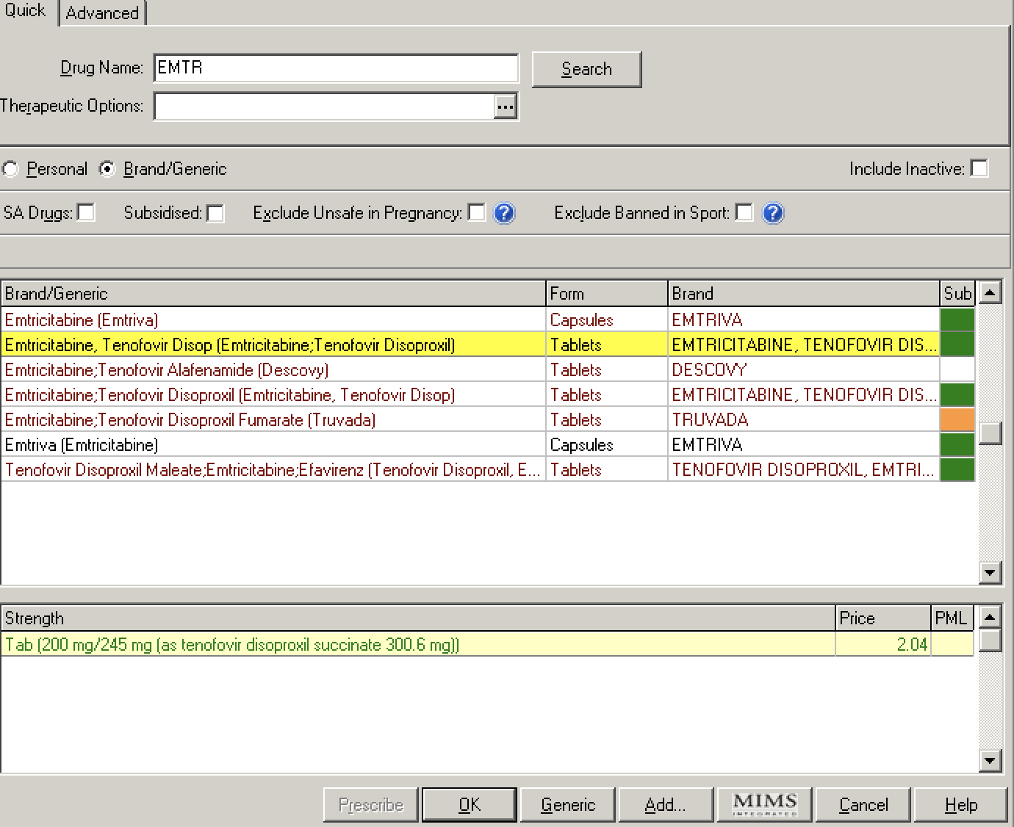
Type “EMT” then press enter – look for “EMTRICITABINE” that’s the one!

Slide 14
Initial Mandatory Testing pre-PrEP
HIV Test – must be negative no more then 14 days prior
Blood tests for syphilis and hepatitis A, B and C – unless known immunity to hepatitis A or B**
Multi site NAAT for chlamydia and gonorrhoea (urine, rectal/vulvovaginal and throat swabs as appropriate) – RED top within 2 weeks
eGFR, serum phosphate and creatinine, urine dipstick (to detect protein), ACR, FBC
Liver function tests
Pregnancy testing in people with childbearing potential
Notes:
HIV test must be 4th generation. IF likely exposure in past two weeks consider intensive testing and ask for advice! If in past 72 hours give post
If chronic hepatitis present – can take PrEP but need to consult Waikato
PrEP is effective ag HepB so must take care of you withdraw as can reactivate HepB

Slide 16
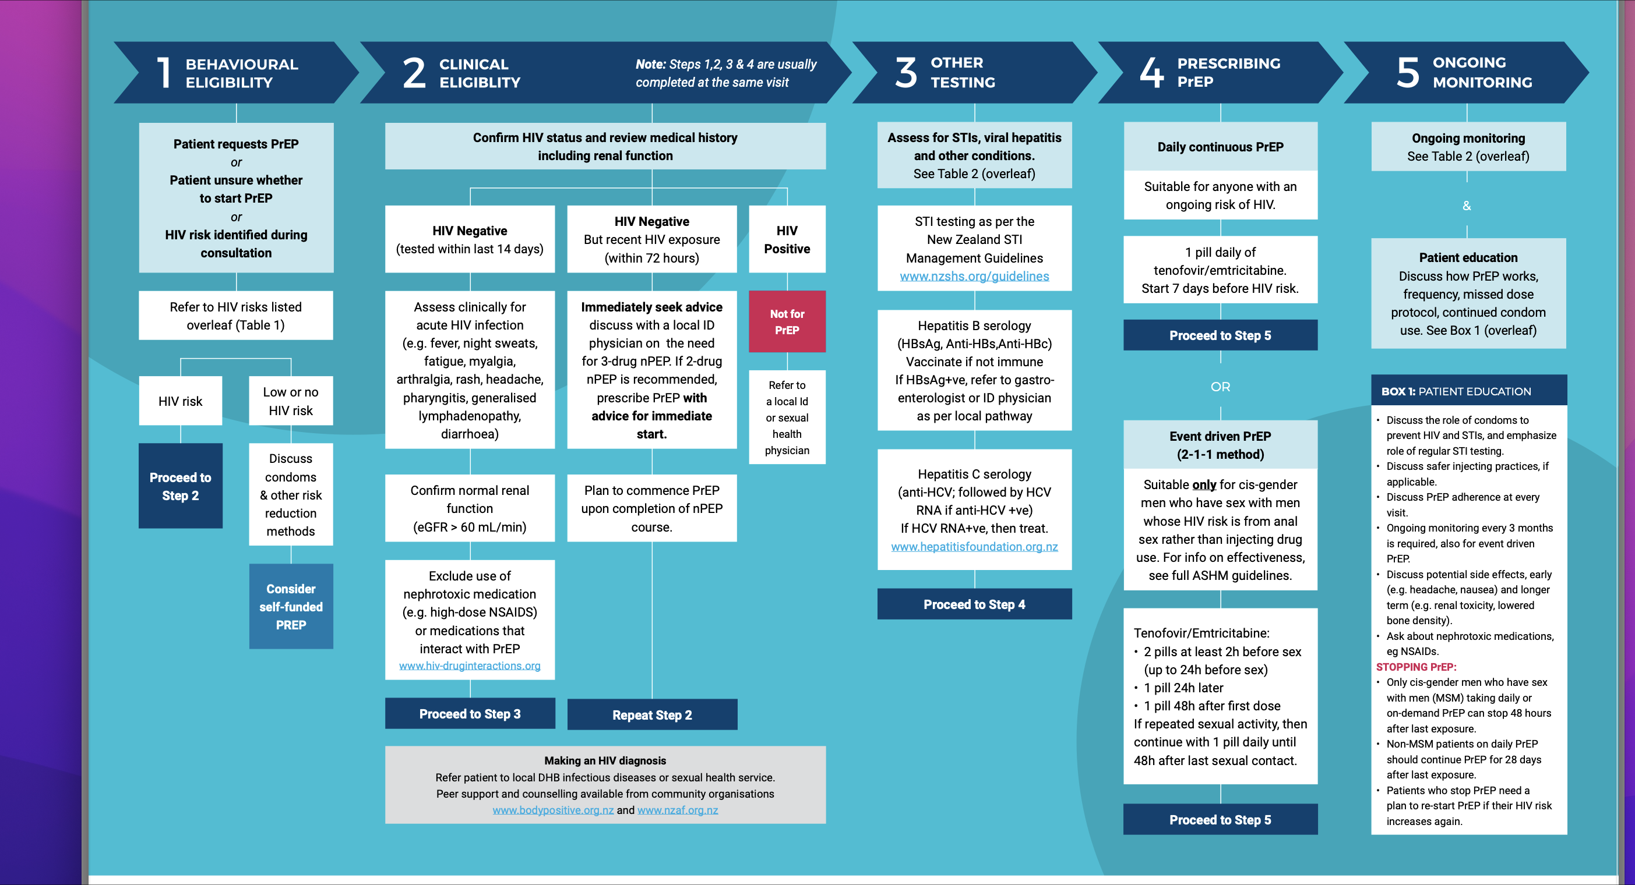
https://www.nzaf.org.nz/media/2884/ashm_prep_tool_nzaf_update_04.pdf

Slide 17
To Note:
Don’t delay if STI present
PrEP CI’d if eGFR <60 mL/min
If not HepB immune, vaccination is recommended prior to starting PrEP
may be increased risk of hepatic adverse effects if HepB +
Ongoing testing for HepB not needed if immune, unless LFTs suddenly elevated
Hep A immunisation also recommended as easily transmitted among MSM – not funded
Contraception is a necessity for females child bearing years and trans males with female repro organs

Slide 18
Ongoing Monitoring
Recommend setting a task 2 weeks before patient set to run out of script
All tests must be done WITHIN 2 weeks re-prescribing prior to SA renewal - full STI screen, including syphilis testing
At 3 Months (must still meet SA criteria)
Renal testing - ** renal toxicity associated with long term, not short use. Assess renal risk carefully
Patient must be advised on the risk of infection with STIs and how to reduce these risks, e.g. the correct and consistent use of condoms
Use NZF for other drug interactions OR https://www.hiv-druginteractions.org
Notes:
Those over 40 years at higher risk (24%) of dropping eGFR <70 after 1 year consecutive treatment
If baseline eGFR<90% also have inc risk drop
HTN, NSAID use and BMI not et associated with renal decline in 4 year FU studies

Slide 19
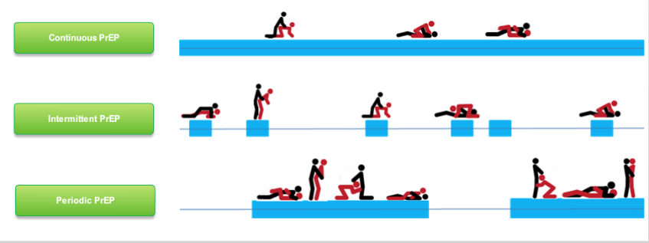
Dosing Strategies
Continuous
Recommended. Take a pill a day. 99% effective
Intermittent
Around planned episode of sex. Better for those who are ‘organised’ or attend pre-planned events
May be a lot cheaper, if medium risk and unfunded
Not recommended as difficult to ascertain if therapeutic drug levels achieved but can be worked out
Periodic “Holiday”
Low risk day-to-day but high risk during holidays
Uncertainties about timing of dose but start 7 days pre event and continue for 28 post last risk exposure (protected 1 week post initiation, but 3 weeks for insertive penile)

Slide 20
Dosing Strategies

Slide 21
Side Effects
In greater than 2% patients:
Headache
Abdo pain, loose stools
Weight loss
Unusual dreams
Recommend to take with food to reduce these
Most noticed first weeks of use and reduce over 3-4 weeks

Slide 22
Serious but Rare/Severe:
Lactic Acidosis
Hepatomegaly with Steatosis -> can lead to liver failure/death
Worsening of HepB if stopped and have chronic infection (discuss with specialist)
Decreased renal function, BMD resistance in those who seroconvert to HIV while on PrEP
BMD not routinely tested
Notes:
If low BMD/thin – counsel to reduce alcohol, smoking and inc Vit D, load bearing activities, calcium
small but significant decline in BMD observed in 3 studies – reversible after withdrawal of TRUVADA and correlated with intracellular levels of the drug

Slide 23
How to Maintain Compliance?
Give a “HOW TO” info sheet to each patient for how to perform their own self swabs
Have a brown bag prepared for 3/12 checks with all supplies needed:
Swabs
Lab form if needed
Two urine pottles
Labels
How to sheet

Slide 24
Stopping PrEP
Recommend that patients wishing to stop treatment continue taking PrEP for 28 days after their last potential exposure to HIV
Any patient with chronic Hep B infection should be discussed with an ID physician
Subsidised PrEP can be reinitiated if the patient’s risk of HIV infection increases in the future

Slide 25
Ready?

