Slide 1
Update on the transition to
HPV primary screening
Taranaki Screen-Takers Update
4 April 2023

Slide 2
Road to Rollout

Slide 3
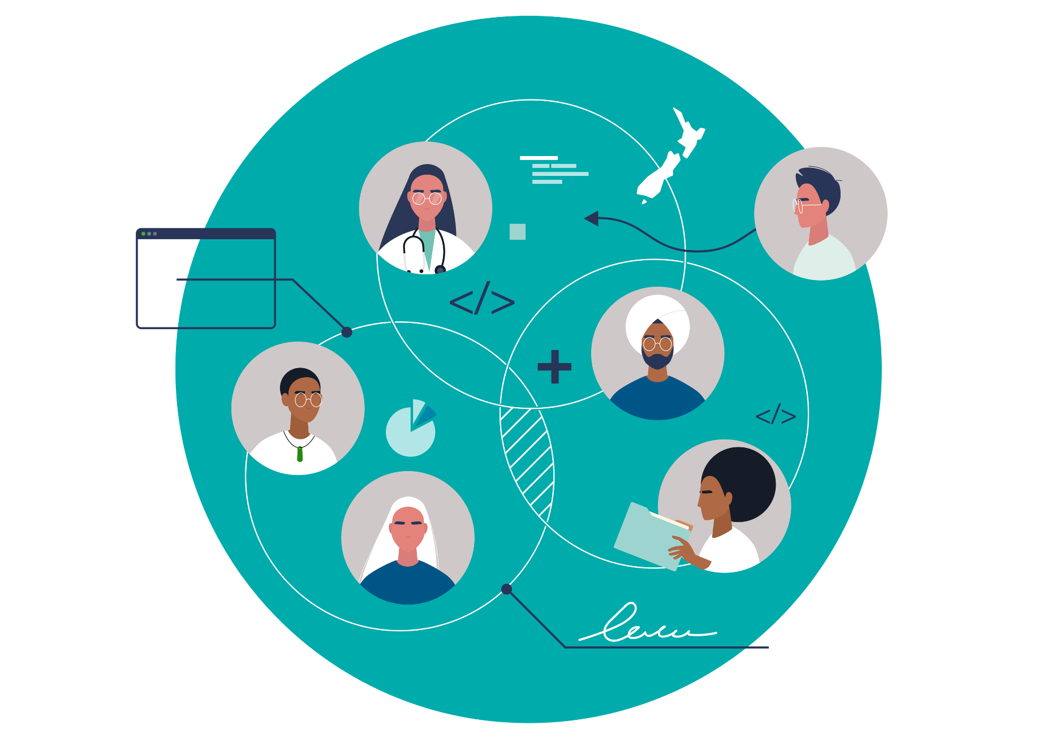
THE VISION – future state
Reaching more participants in their own communities through:
Empowering participants with greater consumer choice about what and how they can participate.
Driving equitable outcomes for Māori and Pacific people.
Greater, more diverse workforce – including greater integration of Kaiāwhina into pathways.
Bringing together the services around the community and consumer.
BRINGING DOWN THE BARRIERS TO SCREENING FOR ALL PARTICIPANTS AND WHĀNAU
3
Notes:
What we will achieve:
HPV swab as primary screening - HPV will find more pre-cancers and prevent more cases of cervical cancer, supported by the speculum and colposcopy tests within the pathways
New NCSP-Register– A single source of truth for screening records and individual schedules
New Pathways – Embedding more choice and flexibility into screening, removing barriers to entry and better supporting and increasing equitable outcomes for Māori and Pacific people
Additional Workforce and Training – Accredited screen-takers/GPs/midwives to do HPV testing as well as LBC test, other Registered nurses can complete HPV test with training

Slide 4
Equity Priorities
New pathways that empower participants with choice; aim to increase participation in Māori and Pacific groups through proactive communication and support.
Enhanced health equity for wāhine Māori and Pacific women through less invasive clinical pathways that meet cultural and access needs combined with targeted outreach to the under-screened population.
Expanding the workforce with more Māori and Pacific clinical and non-clinical staff utilised in the delivery of the initial screening.
4

Slide 5
HPV Primary Screening
The project will support new clinical pathways that will provide greater choice to participants to lift uptake, increase screening in priority groups and reduce mortality rates in our communities.
What we will achieve:
HPV as primary screening test – HPV testing will find more pre-cancers and prevent more cases of cervical cancer, supported by the speculum and colposcopy tests within the pathways.
New NCSP-Register – A single source of truth for screening records and individual schedules.
New Pathways – Embedding more choice and flexibility into screening, removing barriers to entry and better supporting and increasing equitable outcomes for Māori and Pacific people.
Additional Workforce and Training – Accredited screen-takers/GPs/midwives to do HPV testing as well as LBC test, other Registered Nurses can complete HPV test with training.
5

Slide 6
PHASE 1 – FOUNDATIONAL STEP
Participants able to choose self- or clinician-taken HPV swab test, or a speculum test
26 JULY 2023 New clinical pathways rolled out across Primary Care. The NCSP-Register has been implemented and adopted by existing users and the eligible population is improved to support better uptake in screening. Labs and Colposcopy clinics prepared for the new tests and are ready for fluctuating volumes. Increased media campaign activity nationwide to promote the new test. While all participants will be able to choose self- or clinician-supervised HPV screening test, the focus will be on Māori and Pacific participants and increasing screening in the under- or unscreened populations.
HPV Self-test swab.
Clinical HPV swab test.
Clinically administered speculum-based HPV test.
6
Notes:
HPV Home Self-Test - At home
HPV Clinical Self-Test - Supervised in a setting close to the community
New NCSP-Register - A repository of all the information enabling users to stay informed and support taking the right action. The register will support the capability for the participant notifications.
Bringing together the services around the community and consumer like you do in your roles as support to screening services
All about choice - HPV home self test – participants will be able to take the test at home and return to their screening provider,
The new register is going to be a single source of truth, it will act as a database of all the information enabling users to have the most up to date information about participants and support taking the right next step. The register will also support the capability to notify participants.
Because we’re going to have this great source of information integrated across different systems, it’s going to make it easier for all involved across the screening pathway, it’s going to allow primary care to access screening history, it will be integrated the systems used by labs and colp clinics e.g. gynae+ and regional coordination and yourselves will have greater access than current to stay informed and be able to support your wāhine/whānau, the register central team will continue to lead on data escalation and the resolution of issues

Slide 7
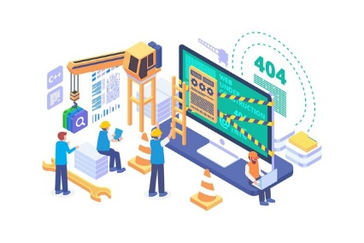
PHASE 2 – Expanding reach
Building on the basics by widening the participant base and increasing uptake.
Estimated timing AUG – DEC 2023
Increasing reach through notifications and expanding where testing becomes available, moving testing closer to our communities. Primary Care now have the ability to easily access screening history.
HPV Self-test swab – with more option for locations outside of a clinical setting.
Clinical HPV swab test - supervised in settings close to communities.
Continuously Evolving
Clinically administered speculum-based HPV test.
7

Slide 8
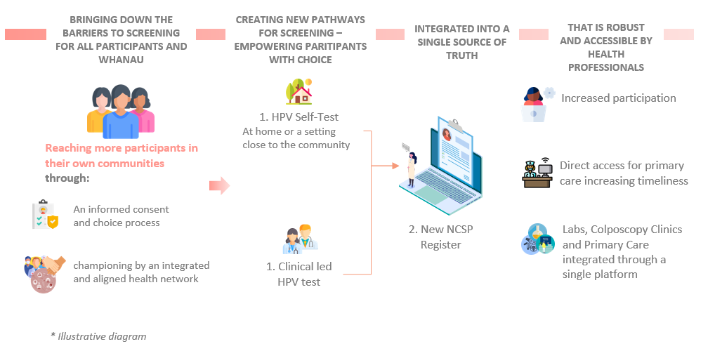
PHASE 3 – Full benefit
Achieving the Future State and moving into continuous improvement
Estimated timing JAN – MARCH 2024
A more complete pool of participants are encouraged into screening, increasing our screening coverage, patient experience and whānau satisfaction. Participants can choose to self-test at home or in a wide variety of settings that work for them. Our workforce feels empowered through training and accreditation to advise and support women through the new pathways. The new NCSP-Register is embedded into our ways of working.
Continuously Evolving
8
Notes:
END STATE (currently out of scope for the project):
Fully Funded - The current model approved by Government does not provide HPV testing to be free and will not be included in the HPV primary screening project. However, it is noted that funding has been a strong recommendation by the Parliamentary Review Committee.
Centralised mail out of tests – Individual clinical settings may mail out tests locally but this will not be run centrally by the NCSP programme in this project.

Slide 9
HPV Primary Screening Delivery Roadmap
PHASE ONE: FOUNDATIONAL STEP - 26 JULY 2023
 | PARTICIPANTS I now have new choices for screening, including the ability to self-test for the HPV virus. I may be offered the opportunity to take the test at home. I will continue to receive notifications from my Primary Care provider.
 | PRIMARY CARE We have completed our training on HPV Primary Screening and are confident in the new pathways, including supporting people through informed consent and the new HPV primary screening tests.
 | COLPOSCOPY CLINICS We are confident, understand the guidelines and have planned to accommodate the variation in volume that might arise for Colposcopy with the introduction of HPV primary screening. We have transitioned to Gynae+ v11 and can access and interact with information from the new NCSP-Register.
 | LABORATORIES We have completed our training and understand the new HPV primary screening process and usage of the new recommendation codes. We are equipped to provide HPV primary screening tests to accredited sample takers (e.g. Primary Care) and test for both HPV and cytology.
 | REGIONAL CO-ORDINATION & SUPPORT TO SCREEN We have completed our training and are confident in promoting, providing advice on, and supporting new choices for screening, with particular focus on priority groups. Our accredited screen takers will be trained in HPV Primary Screening and will be able to access patient data to stay informed. We understand the role everyone has to play in the new pathways.
 | CENTRALISED REGISTER We will use the NCSP-Register user guide and complete the training to continue to manage data on the new NCSP-Register. Across the teams, we will ensure the data consistency and robustness, ensuring integration between the different NCSP-Register users and provide resolution to complex data and clinical issues.

Slide 10
Mana whakahaere |Governance
Outline of the project governance used throughout design and into implementation.
Design Authority Group
Platform Resilience Steer Co.
Te Whatu Ora – Health New Zealand
Te Aka Whai Ora – Māori Health Authority
Data Governance Group
Security Governance Group
National Public Health Service Technology Portfolio Board
Salesforce Governance Group
Prevention Portfolio Board
Māori Monitoring Equity Group
National Screening Action and Advisory Committee
National Screening Unit Steering Committee
National Kaitiaki Group – Cervical only
HPV Project Steering Committee
Sector working groups
NCSP Advisory and Action Rōpū
Equity underpins all the workstreams
Project Leadership
Initial areas of input and advice will sit within the following workstreams:
Campaigns and outreach – particularly for campaigns designed for Māori
Clinical and equity
Notification strategy
Support centre – diverse workforce expansion.
Laboratory Working Group
Pacific Resources & Media Campaign Advisory Group
Campaigns and outreach
Data Migration Steering Group
Māori Resources & Media Campaign Advisory Group
Change and training
The Register
Colposcopy Working Group
Kaimanaaki Working Group
Labs, Colp and Primary Care
Screen-takers Working Group
Register Services Working Group
Monitoring, data and reporting
Support centre
HPV Research Projects
Clinical and equity
10

Slide 11
HPV Primary Cervical Screening

Slide 12
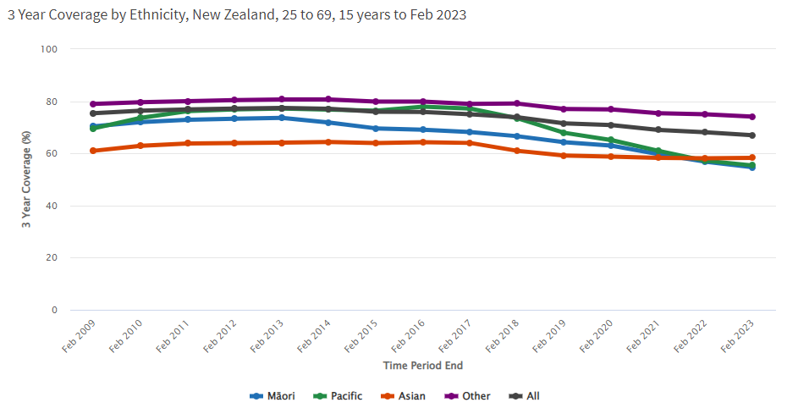
Cervical cancer is preventable
Aim is to eliminate cervical cancer for all ethnic groups in Aotearoa in line with the World Health Organization (WHO) goal 2030.
To achieve this we need to improve our vaccination and screening rates.
Changing to HPV testing is expected to improve participation in cervical screening.
12

Slide 13
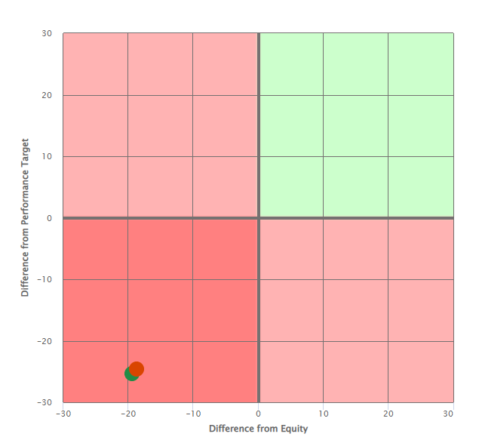
Reaching equity in cervical screening
Equity and performance matrix
The matrix brings together the two measures of equity and performance.
Performance is the difference (percentage point) between the population of interest and Programme target.
Equity is the difference (percentage point) between the performance of the population of interest and the reference population (non-Māori, non-Pacific).
Māori
Difference from equity = -19.4
Difference from performance = -25.3
Pacific
Difference from equity = -18.7
Difference from performance = -24.6
13

Slide 14
Changing to HPV primary screening
This new screening method will test for the presence of human papillomavirus (HPV), the virus that causes more than 95% of cervical cancers.
It is not the same as the current test.
Will detect more high grade changes than the current cytology based programme
The current test looks for cell changes … the HPV test looks for the presence of the virus that causes those changes.
Those who have HPV detected will need further investigation with a cytology test or a referral to colposcopy.
A very small number of cervical cancers are not HPV related: most are adenocarcinomas.
Even if an HPV test is negative, symptoms of cervical cancer still need to be investigated.
14
Notes:
The change to HPV Primary Screening means there will be a new screening method that tests for HPV which is the virus that causes >95% of cervical cancers. There is international evidence and modelling using New Zealand data that predicts HPV screening will reduce the incidence of cervical cancer in BOTH vaccinated and unvaccinated participants. The new test is not the same as the current test, as cytology screening looks for cell changes where as the HPV test looks for the presence of the virus. it’s important to note that with the transition, HPV screening will not be appropriate for everyone, some participants will still require cytology screening if under surveillance, needing a test of cure or those who are clinically indicated.

Slide 15
Screening eligibility?
Any person aged 25 to 69 years who has a cervix who is due or overdue their cervical screen and eligible for publicly funded health care.
This includes trans-men and non-binary people.
Women who have sex with women should be screened.
Those aged 70 to 74 years who have never been screened or are under-screened should have a negative HPV test before ceasing screening.
Māori, Pacific peoples and those who are under-screened (>5 years since last cytology) and never screened should be prioritised.
The new NCSP-Register will be population based, from NHI data.
Participants are still able to opt off.
15
Notes:
so will be able to notify those who have never been screened.

Slide 16
What is HPV?
Human papillomavirus (HPV) is a DNA virus that infects the skin and mucous membranes.
There are over 200 types of HPV, around 40 that effect the genital region.
HPV is passed on by intimate skin to skin contact during sexual activity.
It’s extremely common – four out of five adults will be infected with HPV.
Most HPV infections resolve spontaneously and are asymptomatic.
90% resolve within 2 years of infection.
16
Notes:
80% of sexually active adults will contract HPV in their lifetimes. Four out of five of us
Usually, there are no symptoms
For most people your immune system clears the infection within two years
So you may never know you have had it
No treatment for it … other than the body’s immune system
Feedback we have had from frontline screen takers is that women in same-sex relationships often believe they won’t get HPV... This is not so ... They could have contracted it in past relationships ... They don’t know the sexual history of their current partners.,... They ARE at risk

Slide 17
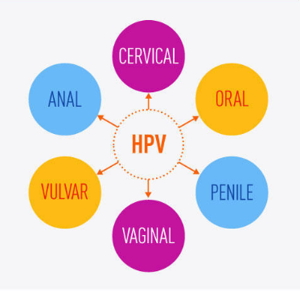
HPV and Cancer
HPV testing tests for:
14 oncogenic types can cause cancer (16, 18, 31, 33, 35, 39, 45, 51, 52, 56, 58, 59, 66, 88).
16 and 18 are the highest risk types and associated with 75% of squamous cell cervical cancers.
For HPV to cause cancer three things are necessary:
High risk type of HPV
Persistence of that infection
Time.
17

Slide 18
Vaccination is vital
The first line of defence against cervical cancer is prevention by HPV immunisation.
The World Health Organization (WHO) target is for a global 90% vaccination rate for girls by the age of 15.
In Aotearoa, HPV immunisation is FREE for everyone aged 9 to 26 years (inclusive).
Offered to rangatahi in year 8 at school and can also be given in Primary Care.
Gardasil-9 is the current vaccine, which includes:
7 high-risk HPV types (16, 18, 31, 33, 45, 52, 58).
2 HPV types against genital warts (6, 11).
Participants who have been vaccinated still need screening as not all hrHPV types are covered by the vaccination.
18

Slide 19
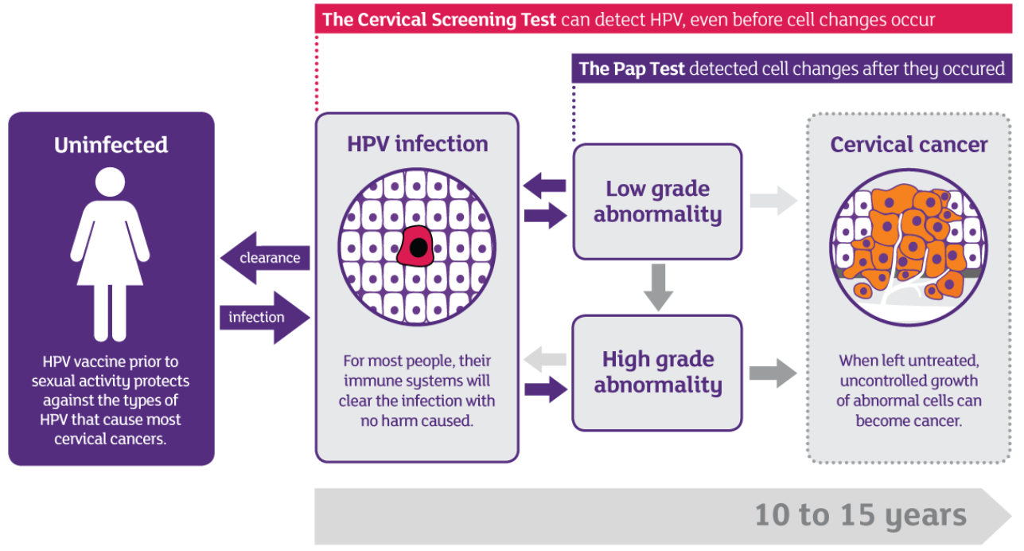
HPV primary screening can detect HPV even BEFORE cell changes occur
Speculum test detects cell changes AFTER they occur
19
Notes:
This diagram shows how HPV Primary Screening intervenes at an earlier point

Slide 20
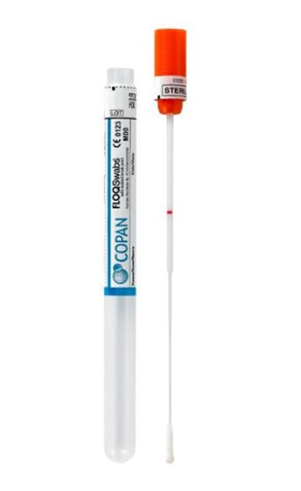
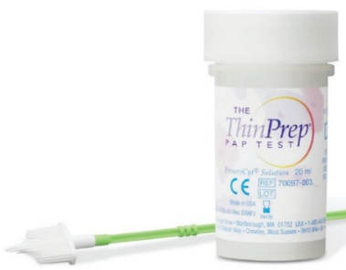
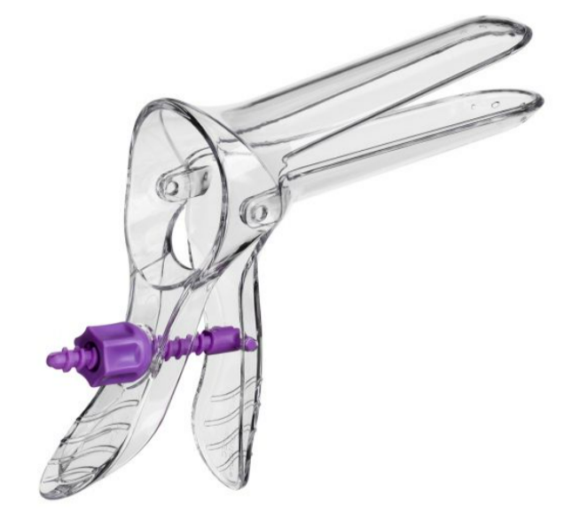
Empowering with choice
Self-testing is not the only option available from July 2023.
Participants have choices:
Choose to self-test (vaginal swab), in a location of their choice.
Opt for a clinician to assist with taking the HPV swab test.
Choose for the clinician to take an LBC sample (previously known as a smear) which will be tested for HPV and if the virus is detected, will be tested for cytology.
Participants need to be reassured that a self-test is just as effective as a clinician-taken sample at detecting the presence of HPV.
Detecting cervical precancer and reaching under-screened women by using HPV testing on self samples: updated meta-analyses Marc Arbyn et al. BMJ 2018;363:k4823 | doi: 10.1136/bmj.k4823
20
Notes:
Key change – and message - participant has choices.
If a wāhine chooses to have a speculum taken LBC test for their primary screening test, the sample will be tested first for HPV.
If the test is positive, cytology will also be reported using the same sample. In that case the participant does not have to return for a second test.

Slide 21
Explaining the HPV self-test
The test is a vaginal swab, so no need to find the cervix.
The participant may self-test in a location of their choice, or opt for a clinician-taken sample.
Self-testing requires informed consent with a clinician taking responsibility for following up the test results and arranging follow-up .
The self-testing option has been proven to increase screening rates of under/never screened wāhine Māori.
21
Notes:
Clinical oversight for self testing - health professional is responsible for: • Advice + informed consent • Providing the test kit to the participant / coordinating getting it back - cannot send out tests centrally • Ensuring Quality Assurance requirements are met (labelling /date etc) • Ensuring the correct lab request information is completed • Ensuring the participant is told of the test result • The result is followed up and the next steps / referrals are completed as needed

Slide 22
The HPV self-test is not adequate for:
Anyone with symptoms:
bleeding (after sex, after menopause, in between periods)
abnormal discharge
pain with sex
pelvic pain.
Anyone needing a Test of Cure (TOC) after a high grade abnormality.
Anyone under surveillance it is recommended to have an LBC because of the increased likelihood that cytology will be required.
22

Slide 23
Results management
~ 90% of people will have HPV not detected – next screen in 5 years.
~ 2.5 % of people will have HPV 16 or HPV 18 detected – refer to colposcopy clinic.
~ 7.5% of people will have HPV Other detected – return for cytology if test was performed on a swab.
If high grade cytology – refer to colposcopy.
If normal or low grade – repeat in 12 months.
When someone has HPV detected ask them again about symptoms.
23

Slide 24
A longer screening interval
The screening interval following a negative HPV test will change to 5 years compared to the current 3 years.
Studies have shown that the risk of pre-cancer 5 years after a negative HPV test is significantly lower than 3 years after a negative cytology test.
So wāhine/whānau can feel confident with this extended interval with HPV primary screening.
An HPV test is more sensitive for detecting abnormalities than a negative cytology test so we don’t need to repeat the HPV test 12 months after a first screen.
24
Notes:
The vast majority of participants who test HPV positive won’t have cancer – but will have follow-up tests
How can the woman feel confident with this extended gap – changing to 5 years? Cervical cancer takes between 10-20 years to develop so a negative HPV test, and re-screening within 5 years, is well within that safe interval.
This screening interval is within other countries such as Australia, UK, and the Netherlands

Slide 25
HPV and relationships
Because we are now testing for HPV, some participants who have had negative cytology tests for years will now test positive for HPV.
A person may have had HPV for many years and never had symptoms.
People who have not had sexual or intimate contact for many years can test positive for HPV.
Some people can become worried about where they got HPV and whether their partner has been unfaithful.
The most important thing to know is that having HPV does not mean that a person or their partner is having intimate sexual contact outside their current relationship.
25

Slide 26
Stopping screening
Everyone should have a negative HPV test before exiting the programme.
Those aged >65 years who have HPV 'not detected' can stop screening (unless still in follow up for a high-grade lesion).
Those aged 70-74 who are unscreened or under screened should have a negative HPV test before ceasing screening.
Those with a total hysterectomy (histological confirmation the cervix has been removed) with a normal screening history can stop screening.
26

Slide 27
Special Considerations
Immunocompromised participants should have screening every 3 years and be referred to colposcopy if any type of HPV is detected.
Pregnancy – HPV testing is safe in pregnancy and should be considered part of routine antenatal screening in those who are due.
27

Slide 28
Key messages
HPV testing is a better primary screening test than cytology.
For some, cytology is still recommended – surveillance, TOC, clinically indicated.
About 10% will have high risk HPV detected, requiring follow-up (cytology or colposcopy).
About 90% will have HPV not detected, their next screen will be in 5 years.
Participants can choose how and where to have their screening test.
Self-collected swabs are just as accurate as clinician-taken samples.
The option of self-testing will reduce barriers and increase participation.
The new Register is population based so will identify more people eligible for screening.
Vaccination is key to reducing cervical cancer in Aotearoa.
Please encourage participants to continue to have cytology screening on time prior to July 2023, rather than waiting for the new test.
28

Slide 29
Training and key dates

Slide 30
Learning approach
A blended learning approach is being developed to support the sector through the transition to HPV primary screening.
Different learning mediums will be created to ensure that each role in the sector has the appropriate education.
Some learning will be delivered as e-modules that may be tracked in a learning management system.
Other mediums will include:
Educational videos
Printed resources
Webinars
In-person education.
30
Notes:
I’ll now provide some information on the learning model we’re working on for the sector. A lot of work has been completed in the background to look at the best ways to approach the learning for the sector and what needs the sector has in terms of learning/training and education.
The approach we’ll be taking to learning will be what we call a blended approach. This means there will be different learning mediums created to ensure that each role in the sector has the appropriate education. Some learning will be mandatory and delivered as e-modules that will be tracked in a learning management system. We’ll also be providing educational videos, printed resources and more webinars. Some in person training may be provided, however to ensure equitable access to learning the majority of educational resources will be made available online.

Slide 31
Foundation Step core e-learning modules
Module 1 | Module 2 | Module 3
Will include: Core info about HPV - what is the virus, issues associated with HPV. What is the relationship between HPV and cancer, and HPV primary screening. HPV vaccination - what is its role in protecting against cervical cancer. | Will include: Updated clinical guidelines HPV test v’s cytology screen Clinical supervision Choices for participants Lab reporting Links to Updated Clinical Practice Guidelines, Policies and Standards. | Will include: Screening principles Informed consent Understanding potential harms associated with screening Cultural perspective on screening Priority population History of programme Significance of Support to Screen and their role.
Notes:
- Looking for SMEs from the sector who will contribute throughout the development of these modules

Slide 32
Key 2023 dates
May
Updated Clinical Practice Guidelines
June
Online training modules available
Public campaign and resources for participants released
July
GO LIVE – HPV Primary Screening
Colposcopy Clinics delivering HPV Primary Screening
New NCSP Register in use
Laboratories processing HPV test
32

Slide 33
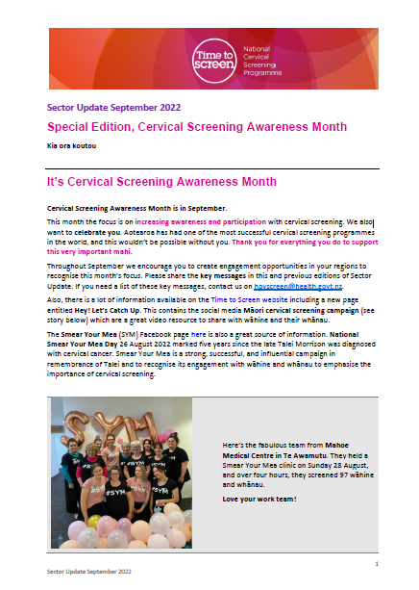
For more information and giving feedback
Have you seen our Sector Update monthly newsletter?
Get added to the distribution list by emailing us at HPVScreen@health.govt.nz
Health Professionals pages on the NSU website contain FAQs: here
We also have answered an extensive list of clinicians’ questions from a Goodfellow Unit webinar, which can be found here
Your feedback is important. Contact us on hpvscreen@health.govt.nz
We’re here to support you through these changes.
33
Notes:
If you would like to have more information about the transition to HPV Primary Screening, we have multiple resources available. We send out a monthly sector update which you can request to receive by emailing the address on screen.
There is a FAQ page on the NSU website under the health professionals section and we have also answered an extensive list of clinical questions after our last webinar which was held with the Goodfellow unit. These questions are available on the NSU website as well.

Slide 34
National Cervical Screening Programme update

Slide 35
Aotearoa coverage by ethnicity
 | POPULATION SEP 2008 | POPULATION FEB 2023 | SCREENS SEP 2008 | SCREENS FEB 2023 | COVERAGE SEP 2008 | COVERAGE FEB 2023 | SCREENS TO REACH EQUITY
Māori | 136,203 | 207,794 | 94,117 | 113,653 | 69.1% | 54.7% | 40,392
Pacific | 57,378 | 85,442 | 38,512 | 47,376 | 67.1% | 55.4% | 15,965
Asian | 117,355 | 260,056 | 70,667 | 151,632 | 60.2% | 58.3% | 41,157
Other | 766,386 | 820,068 | 603,632 | 607,945 | 78.8% | 74.1% | 0
All | 1,077,322 | 1,373,360 | 806,928 | 920,606 | 74.9% | 67.0% | 97,514
National Cervical Screening Programme Coverage Report (shinyapps.io)
35
HPV Primary Screening Project
Notes:
Here is a comparison between the Sep 2008 and Sep 2022, being the oldest and most current sets of data on the 'shiny app' NSU site
Note the increase in population across ethnicities.
Māori specific to reaching equity of which >40,000 screens are needed to reach equity currently, sitting at 54.8% where in 2008 coverage was 69.1%
Huge differences.

Slide 36
Taranaki coverage by ethnicity
FEB 2023 | POPULATION | SCREENS | COVERAGE | SCREENSTO REACH EQUITY
Māori | 5,954 | 3,804 | 63.9% | 955
Pacific | 402 | 389 | 71.9% | 32
Asian | 1,812 | 1,286 | 71.0% | 162
Other | 24,469 | 19,556 | 79.9% | 0
All | 32,637 | 24,935 | 76.4% | 1,149
National Cervical Screening Programme Coverage Report (shinyapps.io)
36
HPV Primary Screening Project
Notes:
Here is a comparison between the Sep 2008 and Sep 2022, being the oldest and most current sets of data on the 'shiny app' NSU site
Note the increase in population across ethnicities.
Maori specific to reaching equity of which >40,000 screens are needed to reach equity currently, sitting at 54.8% where in 2008 coverage was 69.1%
Huge differences.

Slide 37
Any Pātai?
37
Notes:
That brings us to the end of our presentation tonight, e mihi ana ki a koutou. We now have about 20 minutes to answer any questions you might have.

Slide 38
Māori and Pacific campaigns
Cervical screening | Time to Screen - National Screening Unit
38

Slide 39
Te Matatini 2019
Mana Wāhine collective
54 wāhine/whānau screened
Paved the way x
Te Matatini 2023
Ride for Talei + Hauora Providers Pōneke to Tāmaki
85 screened ( incl. 2 HPV)
Te Matatini Tāmaki collective 131 screened (incl. 51 HPV)
216 total whanau screened
163 cervical, 53 HPV
39
National Cervical Screening Programme

Slide 41
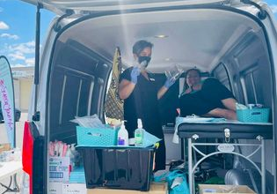
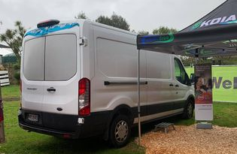
National Cervical Screening Programme

Slide 42
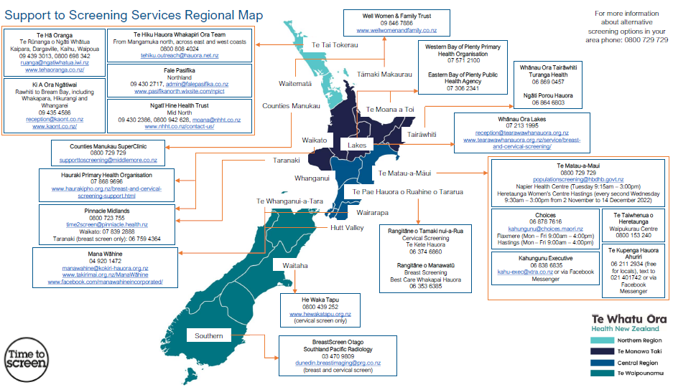
42
Screening Support Services | National Screening Unit (nsu.govt.nz)
Notes:
Nadine – using the new one I was unable to transfer it into here with the links and everything working, so this is just a straight screen grab sorry – it won't be interactive.
Dual approach Breast and Cervical
Screening Support Services are available for eligible wāhine/whānau who are referred to, or who independently access the services. This support can assist those who experience barriers to accessing breast and cervical screening, assessment and treatment services.
Some support to screening providers have mobile teams who make community visits and home visits, while others are based in clinics around the motu.
The teams are a mixture of clinical and non-clinical staff, inclusive of kaiāwhina (support staff).
Eligible wāhine/whānau are Māori and Pacific aged 25–69; and all wāhine/whānau aged between 30–69 who have never had a cervical screen, or have not had a cervical screen in the previous five years.
https://www.nsu.govt.nz/health-professionals/national-cervical-screening-programme/ncsp-workforce/screening-support-services

Slide 43
HPV Primary Screening Delivery Roadmap
PHASE ONE: FOUNDATIONAL STEP - 26 JULY 2023
PHASE TWO: EXPANDING REACH – Aug to Dec ‘23
PHASE THREE: FULL BENEFIT – Dec to Mar ‘24
 | I now have new choices for screening, including the ability to self-test for the HPV virus. I may be offered the opportunity to take the test at home. I will continue to receive notifications from my Primary Care provider. | I will continue to receive notifications from my Primary Care provider. However, if I am not enrolled in Primary Care – I will now be notified if under- or unscreened. Māori and Pacific participants will be proactively encouraged to screen. | I feel empowered through choices, feel supported to make these decisions, have been actively notified of changes and have a wide variety of test locations close to my community, including testing at home.
PARTICIPANTS
 | We have completed our training on HPV primary screening and are confident in the new pathways, including supporting people through informed consent and the new HPV primary screening tests. | We have the ability to easily access screening history and have received training. We can use the NCSP-Register to improve communication and/or referrals with laboratories and all participants. | We have the ability to proactively reach our most unscreened populations. We are working towards building up our workforce through training in the HPV primary screening process.
PRIMARY CARE
COLPOSCOPY CLINICS
 | We are confident, understand the guidelines and have planned to accommodate the variation in volume that might arise for Colposcopy with the introduction of HPV primary screening. We have transitioned to Gynae+ v11 and can access and interact with information from the new NCSP-Register. | We will be working with central support teams to deliver all reporting and monitoring relating to Colposcopy services.
 | We have completed our training and understand the new HPV primary screening process and usage of the new recommendation codes. We are equipped to provide HPV primary screening tests to accredited sample takers (e.g. Primary Care) and test for both HPV and cytology. | We will continue to work with the NSCP programme around improvements to the monitoring system and implementation of KPIs. We continue to report using updated clinical practice guidelines. Each histology lab will have agreed transition plans for new SNOMED-CT codes.
LABORATORIES
 | We have completed our training and are confident in promoting, providing advice on, and supporting new choices for screening, with particular focus on priority groups. Our accredited screen-takers will be trained in HPV primary screening and will be able to access patient data to stay informed. We understand the role everyone has to play in the new pathways. | We now have more notification services and will be able to access up-to-date information on participants and their journey. We will be able to access reporting on the population and screening. More effective use of our non-clinical staff, such as Kaiāwhina, in the delivery of the HPV project will be scoped by central teams. | We have the ability to proactively reach our most unscreened populations. We are working towards building up our workforce through training in the HPV primary screening process.
REGIONAL CO-ORDINATION & SUPPORT TO SCREEN
CENTRAL REGISTER TEAM
 | We will use the NCSP-Register user guide and complete the training to continue to manage data on the new NCSP-Register. Across the teams, we will ensure data consistency and robustness, ensuring integration between the different NCSP-Register users and provide resolution to complex data and clinical issues. | We will support the notification process for the overdue and under-screened, including those priority groups. | We will support the ability to proactively reach all our participants via notifications.

Slide 44
HPV Primary Screening
THE VISION
The HPV primary screening project will support new clinical pathways that will provide greater choice to participants to lift uptake, increase screening in priority groups and reduce mortality rates in our communities.
Reaching more participants in their own communities through:
What we will achieve:
HPV as primary screening test – HPV testing will find more pre-cancers and prevent more cases of cervical cancer, supported by the speculum and colposcopy tests within the pathways.
New NCSP-Register – A single source of truth for screening records and individual schedules.
New Pathways – Embedding more choice and flexibility into screening, removing barriers to entry and better supporting and increasing equitable outcomes for Māori and Pacific people.
Additional Workforce and Training – Accredited screen-takers/GPs/midwives to do HPV testing as well as LBC test, other Registered Nurses can complete HPV test with training.
Empowering participants with greater consumer choice about what and how they can participate.
Driving equitable outcomes for Māori and Pacific people.
Greater, more diverse workforce – including greater integration of Kaiāwhina into pathways.
PHASE 3: Full benefit
Phase 2: Expanding reach
Bringing together the services around the community and consumer.
FOUNDATIONAL STEP
Achieving the future vision
BRINGING DOWN THE BARRIERS TO SCREENING FOR ALL PARTICIPANTS AND WHĀNAU
Focus on increasing uptake through notifications
A more complete pool of participants are encouraged into screening, increasing our screening coverage, patient experience and whānau satisfaction. Participants can choose to self-test at home or in a wide variety of settings that work for them. Our workforce feels empowered through training and accreditation to advise and support participants through the new pathways. The new NCSP-Register is embedded into our ways of working.
Participants able to choose self- or clinician-supervised HPV primary screening test, or a speculum test
Increasing reach through notifications, including under- and unscreened populations not enrolled in primary care. NCSP-Register rolled out to primary care.
EQUITY PRIORITIES
New pathways that empower participants with choice; aim to increase participation in Māori and Pacific people through proactive communication and support
Enhanced health equity for wāhine Māori and Pacific people through less invasive clinical pathways that meet cultural and access needs combined with targeted outreach to the under-screened population.
Expanding the workforce with more Māori and Pacific clinical and non-clinical staff utilised in the delivery of the initial screening.
New clinical pathways and NCSP-Register rolled out. Participants will be able to choose self- or-clinician-supervised HPV screening test, with the focus on Māori and Pacific participants and increasing screening in the under- or unscreened populations.
Implementation Progression
Initial Rollout 26th July
AUG - DEC
DEC- MAR ‘24
Notes:
where stigma, cultural norms and lack of trust in western institutions drives under- and unscreened participation.

Slide 45
HPV Primary Screening Delivery Roadmap
PHASE TWO – Aug to Dec
PHASE THREE – Dec to Mar
 | PARTICIPANTS | I will continue to receive notifications from my Primary Care provider. However, if I am not enrolled in Primary Care – I will now be notified if under- or un-screened. Māori and Pacific participants will be proactively encouraged to screen. | I feel empowered through choices, feel supported to make these decisions, have been actively notified of changes and have a wide variety of test locations close to my community, including testing at home.
 | PRIMARY CARE | We have the ability to easily access screening history and have received training. We can use the NCSP-Register to improve communication and/or referrals with laboratories and all participants. | We have the ability to proactively reach our most unscreened populations. We are working towards building up our workforce through training in the HPV primary screening process.
 | COLPOSCOPY CLINICS | We will be working with central support teams to deliver all reporting and monitoring relating to Colposcopy services.
 | LABORATORIES | We will continue to work with the NSCP programme around improvements to the monitoring system and implementation of KPIs. We continue to report using updated clinical practice guidelines. Each histology lab will have agreed transition plans for new SNOMED-CT codes.
 | REGIONAL CO-ORDINATION AND SUPPORT TO SCREEN | We now have more notification services, and will be able to access up-to-date information on participants and their journey. We will be able to access reporting on the population and screening. More effective use of our non-clinical staff, such as Kaiāwhina, in the delivery of the HPV project will be scoped by central teams. | We have the ability to proactively reach our most unscreened populations. We are working towards building up our workforce through training in the HPV primary screening process.
 | CENTRAL REGISTER TEAM | We will support the notification process for the overdue and under-screened, including those priority groups. | We will support the ability to proactively reach all our participants via notifications.

Slide 46
Te Ara Matua| Participants' Delivery Roadmap
The roadmap identifies the phases of the HPV Primary Screening rollout and the impact on the individual groups.
EQUITY PRIORITIES
Phase 2
Phase 3
Phase 1 - Foundational Step
Phase 2
Phase 3
Phase 1: Foundational Step
I have the choice around the type of test I can do and can complete the initial screen in a setting more comfortable for me.
My beliefs and values have been understood and supported through the process, due to the cultural training received by the staff.
I feel more comfortable during screening process, surrounded by more Māori and Pacific clinical and non-clinical staff.
I have received and viewed campaigns from trusted faces and in language that resonated with me and I feel empowered to take the next step.
 | I now have new choices for screening, including the ability to self-test for the HPV virus. I may be offered the opportunity to take the test at home. I will continue to receive notifications from my Primary Care provider. | I will continue to receive notifications from my Primary Care provider. However, if I am not enrolled in Primary Care – I will now be notified if under- or unscreened. Māori and Pacific participants will be proactively encouraged to screen. | I feel empowered through choices, feel supported to make these decisions, have been actively notified of changes and have a wide variety of test locations close to my community, including testing at home.
All participants will be given more choice in their pathway, supported by an integrated and aligned health system
From Phase 1, while participants will be able to choose self- or-clinician-supervised HPV screening test, the focus will be on Māori and Pacific participants and increasing screening in the under- or unscreened populations.
Supported in a range of clinical settings and services, including Primary Care and screening support services. Participants will be actively engaged with media campaigns through a variety of channels to understand the changes and new choices available.
The population-based NCSP-Register will mean that more people will be identified as eligible for HPV primary screening and the new Opt-Out setting will mean more eligible participants are encouraged to screen.
PEOPLE
The Time to Screen and National Screening Unit (NSU) website will include all up to date information to access and support decision making, including comprehensive FAQs about the new change. Notifications will continue through Primary Care.
TECHNOLOGY
46

Slide 47
Te Ara Matua| Primary and Community Care Delivery Roadmap
The roadmap identifies the phases of the HPV Primary Screening rollout and the impact on the individual groups.
EQUITY PRIORITIES
Phase 1: Foundational Step
Phase 2
Phase 3
My training included key cultural considerations that allow me to deliver for all participants, especially Māori and Pacific priority groups.
We can reach out to our target priority groups as ethnicity is reliably captured in the new Register.
 | We have completed our training on HPV primary screening and are confident in the new pathways, including supporting people through informed consent and the new HPV primary screening tests. | We have the ability to easily access screening history and have received training. We can use the NCSP-Register to improve communication and/or referrals with laboratories and all participants. | We have the ability to proactively reach our most unscreened populations. We are working towards building up our workforce through training in the HPV primary screening process.
We feel empowered to deliver the new clinical pathways and support all participants through informed consent
We will receive clinical training on the new pathways, HPV test taking, informed consent. Current LBC screeners will be provided with top up training for the new pathways. A blended learning approach will ensure the principles of Te Tiriti o Waitangi, and Te Ao Māori are upheld and will be delivered through a combination of e-learning, webinars and in-person. Additional support material including new user guides are available via clinical pathways and NCSP Policy and Standards (P&S) will be updated. We have received new public-facing resources that will enable us to effectively educate participants on the new programme, where they can choose, and what happens next.
PEOPLE
PROCESS
We can now order HPV primary screening tests and receive results. We have sufficient HPV primary screening test kits in place.
We will continue to use existing processes, via the support phone numbers, as we will not yet have access to the new NCSP-Register. We will be provided with information to support participant follow-up.
TECHNOLOGY
47

Slide 48
Te Ara Matua| Regional Co-Ordination & Support to Screen Delivery Roadmap
The roadmap identifies the phases of the HPV Primary Screening rollout and the impact on the individual groups.
Phase 1: Foundational Step
Phase 2
Phase 3
EQUITY PRIORITIES
 | We have completed our training and are confident in promoting, providing advice on, and supporting new choices for screening, with particular focus on priority groups. Our accredited screen-takers will be trained in HPV primary screening and will be able to access the NCSP-Register to stay informed. | We now have more notification services, and will be able to access up-to-date information on participants and their journey. We will be able to access reporting on the population and screening. More effective use of our non-clinical staff, such as Kaiāwhina, in the delivery of the HPV project will be scoped by central teams. | We have the ability to proactively reach our most unscreened populations. We have now built up our workforce through training in the HPV primary screening process.
We are able to bring initial screening closer to the whānau with the new pathways and have a clear focus in supporting priority populations (e.g. Māori and pacific).
Our new training allows us to deliver more culturally specific support.
The less invasive pathways allow us to encourage more un and under-screened women through the process.
We can leverage the campaigns, to identify, access and support more participants through the screening process.
Regional co-ordinators can leverage the improved Register to target more Māori and Pacific participants with support.
More Māori and Pacific clinical and non-clinical staff are utilised in the delivery of the initial screening.
We feel empowered to support participants through the new pathways and our accredited screen-takers can deliver the new HPV primary screening test in different clinical settings.
We have received training on the new HPV testing programme. We have received new public-facing resources that will enable us to effectively educate participants and communities on the new programme, where they can choose, and what happens next.
As Support to Screen; we will promote, provide advice on and support new choices for screening. We will support screening in mobile teams, making community visits and home visits, or be based in clinics around the motu. As regional co-ordinators; we will continue to be the critical interface; supporting enquiries and signposting to the correct resolution and escalating queries to Whakarongorau and the support centre.
PEOPLE
Our accredited screen-takers can deliver the new HPV primary screening test in different clinical settings and provide clinical oversight for self-test options.
PROCESS
We will have access to information in the new NCSP-Register and tools to enable me to provide the support.
TECHNOLOGY
48

