Slide 1


Understanding Your Data Sharing Agreement
A guide for GPs, Practice Managers, and Practice Owners on the Primary Care Health Target data sharing initiative — what it means for your practice, your patients, and your funding.
PRIMARY CARE
DATA SHARING
HEALTH NZ

Slide 2
In summary
The risks
De-risking
PHO recommendation
Owner / managers should discuss options – Pinnacle sees opting "in" as the best option.
Contact Pinnacle if you need any help understanding the agreement clause by clause
If opting "in" - send signed ISA by 31st March
If opting "out" - let us know ASAP
Support and Email for completed ISAs
mhnadminteam@pinnacle.health.nz
Limited liability, standard based, vendor compliance, cyber-insurance
Contracted Provider and PHO representatives at PSAAP
Privacy Impact Assessment – no need to reconsent, collateral will be produced
Changes subject to the data governance group and PSAAP review
Sharing data raises a cybersecurity risk
The data collected informs the PHCT the details of which are subject to the PSAAP process
Patients will question what is being shared and why
The data requested NOW will be added to in the future

Slide 3
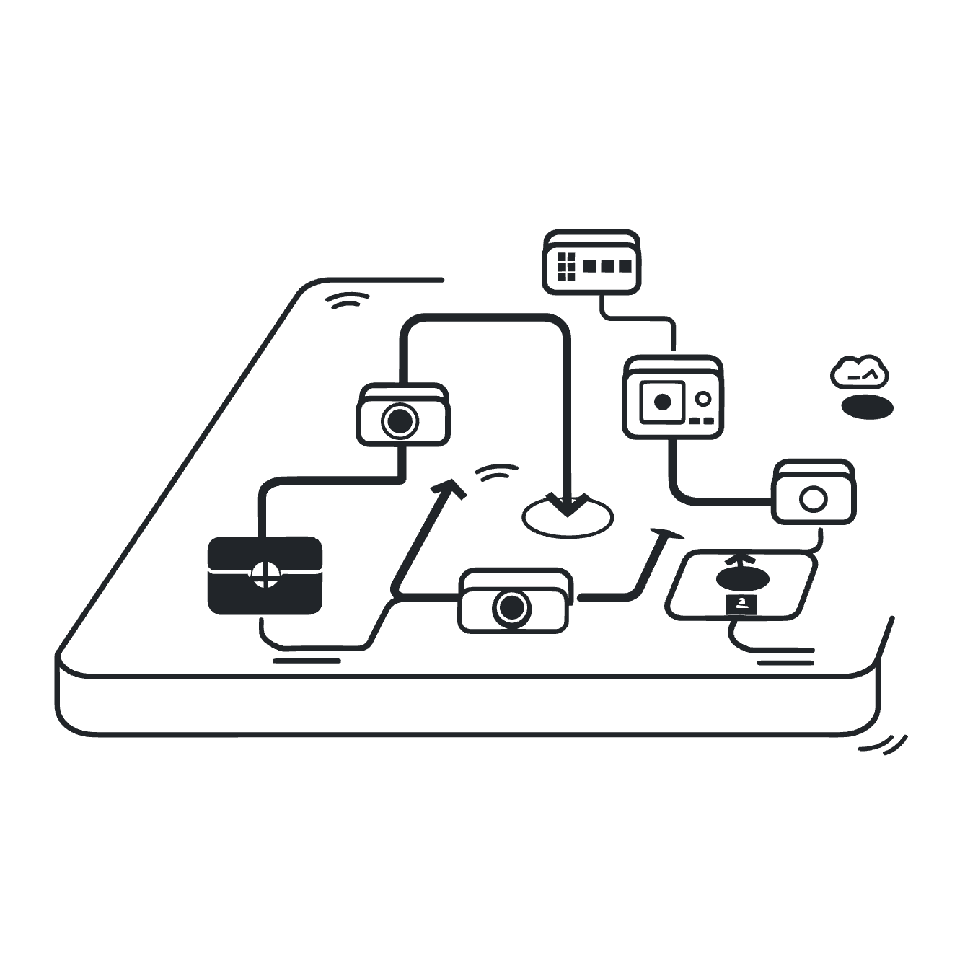


Context
Data Already Flows From Your Practice
Your Patient Management System (PMS) already shares data with Health NZ today via PHO / labs / AIr etc — for example, immunisation records and prescribing information.
This data sharing is well established and forms a critical part of national health management.
What's changing is the introduction of a new, separate data feed direct to TWO focused specifically on appointment wait times to inform the PHCT.
This new feed is designed to strengthen the timeliness and ongoing accuracy of primary care data at a national level.
It has been in development for at least 8 months and undergone numerous iterations

Slide 4


What's New: The Appointment Wait Time Feed
The new data feed covers 12 specific items — all relating to the time between an appointment being booked and being delivered. No clinical notes, diagnoses, or financial data are included.
What IS Shared
Appointment booking dates, delivery dates, and time intervals — anonymised and aggregated.
What is NOT Shared
No clinical notes, diagnoses, medication lists, classifications, or financial information.

Slide 5

The Minister has determined this target and TWO is charged with implementing it.
The details are emerging still.
A working group including CP reps and PHOS and researchers has been working on the protecting patients from unintended consequences.
Publication to the public will be at PHO / district level.
Practice level data will be known to practices, PHOs and HNZ/TWO
Individual Providers will not be identified.
Context
PHCT
"80% of patients are seen within 1 week of wanting an appointment"
It is unclear if this will be incentivised or just a "measure"
PSAAP negotiations underway – expect to be completed by end of June 2026

Slide 6
Chapter 1 of 3
Why This Matters for Your Practice
Understanding the value of signing the agreement — for your funding, your patients, and the future of primary care.

Slide 7



Three Reasons to Sign Up
Continued Funding
System Visibility
Future Investment
Practices will continue to receive the $12 per ESU contingent capitation funding. Signing the agreement is required to maintain this.
The health system gains meaningful visibility of the volume and pace of work being done in primary care — work that is currently under-recognised.
Better data has historically driven increased investment in hospital and specialist services. Primary care deserves the same evidence base.

Slide 8
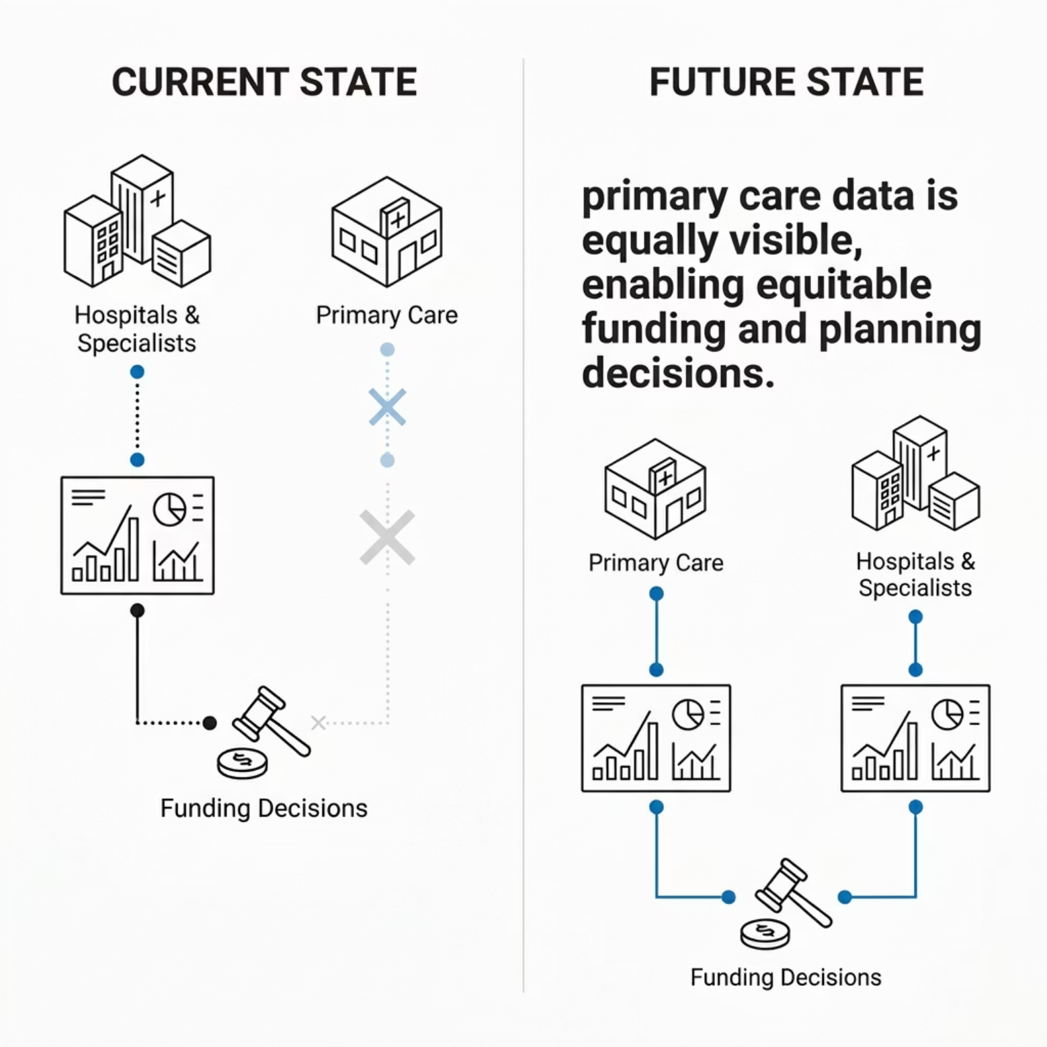


The Bigger Picture
When the health system understands primary care work in as much detail as it understands hospital and specialist services, it fundamentally strengthens future funding and planning decisions in support of GPs and their teams.
This data sharing is an investment in the long-term recognition and resourcing of general practice across Aotearoa New Zealand.

Slide 9
Chapter 2 of 3
Privacy & Data Security
A plain-language summary of how your patients' data is protected under the agreement.

Slide 10

Built on Strong Privacy Foundations
The agreement has been designed to comply fully with New Zealand's Privacy Act 2020 and the Health Information Privacy Code 2020. Te Whatu Ora has confirmed that data use aligns with these laws and is restricted to approved statistical and reporting purposes only.

Slide 11

How Patient Data is Protected
De-identification & Encryption
Restricted Access
All NHI numbers are encrypted and masked during data transformation. Information is anonymised and aggregated — individuals cannot be identified in any published report.
Access is strictly limited to personnel with a direct role in Primary Care Health Target (PCHT) activities. All infrastructure access is logged and audited.
Data Retention & Disposal
Stays in New Zealand
Data held by Te Whatu Ora's agent (Datacraft) is deleted within 30 days of delivery. Once no longer needed, all data is destroyed.
Data cannot be transferred, stored, or used outside Aotearoa New Zealand, except within a secure Te Whatu Ora environment based in Australia.

Slide 12


Security Incident Response
In the unlikely event of a security breach, all parties are required to act immediately — identify, contain, and remedy the issue. Each party must notify the other promptly and cooperate fully.
Liability Threshold
Your Insurance
Each party is liable for the first $5k of breach costs. Te Whatu Ora pays practices if they are the cause. Practices may contribute up to $5k only if they are the cause.
Check your cybersecurity insurance policy — it may cover your exposure in the event of an incident.

Slide 13
Chapter 3 of 3
Talking to Your Patients
What you need to know about patient consent, communication, and transparency.

Slide 14



No Need to Re-Consent Patients
This data sharing is already covered by your current patient consent form. You do not need to seek new consent from patients before their data is included.
To support transparency, Te Whatu Ora will:
Publish a public-facing webpage explaining how patient health information is used and protected
Provide practices with patient-facing materials including flyers and Q&A documents
Reidentification of individuals from anonymised data is explicitly prohibited under the agreement.

Slide 15







Key Protections at a Glance
Privacy Law Compliance
Encrypted & Anonymised
Full alignment with the Privacy Act 2020 and Health Information Privacy Code 2020.
NHI numbers masked; data aggregated so no individual can be identified.
Role-Based Access
Timely Disposal
Strictly limited to approved PCHT personnel; all access logged and audited.
Agent data deleted within 30 days of delivery; fully destroyed once purpose is met.
Stays in NZ
Vendor Compliance
Data cannot be used or stored outside Aotearoa New Zealand.
Your PMS vendor is already aware of and bound by the same security standards.

Slide 16


Ready to Sign? Here's What to Do Next
01
02
Review the Agreement
Attend a Drop-In Session
Join us on 17 March (6.30pm) or 26 March (5.30pm) to ask questions and get clarity on anything in the agreement.
Download and read the data sharing agreement (PDF) — 12 data items, all related to appointment wait times.
03
Sign & Submit
Email your completed ISA to mhnadminteam@pinnacle.health.nz to confirm your participation and protect your funding.
Practices that opt out (or do not return their ISA by 31st March) will stop funding from 30th April – those that opt in – data willl start to flow from July 1st 2026

Slide 17
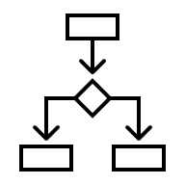
Options to consider ..
Opt "out" / don't return ISA by March 31st
Funding stops April 30th
Data never flows
Opt "in"
Funding continues
Data flows July 1st
Opt "out" now and "opt in" after March 31st
Funding stops April 30th
Funding restarts / data flows from January 2027
Opt "in" now and "opt out" after March 31st
Funding continues until end of January 2027
Data flows July 1st until end of January 2027
Opt "out" at any time – funding and data flows until next Jan 31st or June 30th depending on date of "opt out" decision.

Slide 18

Time for questions
PInnacle leadership will support individual teams to understand the ISA if requested.
By March 31st "Opt out" decisions or signed ISA to be sent to :
mhnadminteam@pinnacle.health.nz
NB If TWO/HNZ don’t get a signed ISA they will assume the practice has opted "out"

